Slide 1
Continuous School Improvement Plans and Strategic Plans
Carol Aversa, M.Ed.
Northeast Accreditation Director
carol_aversa@acsi.org
484-330-1934
Notes:
Welcome to Continuous School Improvement Plans and Strategic Plans. My name is Carol Aversa and I am the Northeast Accreditation Director with ACSI. Please keep my contact information for followup after this presentation.

Slide 2
Notes:
ACSI has been careful to listen and understand the needs of our members. After garnering feedback from our schools, it was determined that many school have similar questions. Several questions in particular are: What is a strategic plan? What is a continuous school improvement plan? Are they the same thing? Today’s presentation will outline the objectives of both documents, critical elements, and guide you toward development or enhancement of the plans for your school. As we look at the WHY the WHAT and the HOW of both documents, be certain to reflect on how these two documents can best serve in guiding your school’s growth and sustainability.

Slide 3
WHY? Continuous School Improvement Plan
Provide Guidance and Direction
Alignment with Mission and Vision
Allocation of Resources
time
personnel
budget
Strengthening of Program
Notes:
When looking at needs and growth areas of schools, it is easy to get excited with ideas and recommendations, while also becoming overwhelmed by the long list that can often develop! Continuous school improvement plans help bring structure. It is important to be certain that your actions are in alignment with mission and vision of your school. There are many great approaches and projects, but not all align to the specific mission and vision of your school..
By bringing structure through these documents, it becomes easier to allocate time, personnel, and budget resources and to prioritize your objectives. Finally, the CSIP is designed to strengthen your program by addressing and directing forward motion of your school. Without these plans, schools can become stagnant. In today’s educational market, our school’s excellence and innovation is even more important in reaching our families’ needs.

Slide 4
Standard Eight in the REACH 2019 accreditation protocol requires, “The school must, with appropriate stakeholder input, systematically develop and annually update a continuous school improvement plan (CSIP). The plan, based on the school’s philosophy, mission, vision, core values, and schoolwide expected student outcomes, includes specific goals, as well as action items. The process is driven by data collection and analysis. This plan must have significant focus on how it will promote organizational growth and high achievement of schoolwide expected student outcomes. The CSIP reflects a pervasive culture of ongoing improvement and accountability. The CSIP should reflect major goals determined as priorities through the self-study process
Notes:
If we look at the standards of accreditation standard 8 addresses the development of a CSIP. It is important to note that this document (and also the strategic plan) are not simply documents to be written and placed in a file, (or made available to the accreditation visiting team!) but are meant to be developed through stakeholder input and updated annually. This should be a document based on the school’s guiding principles and always be directed toward schoolwide expected student outcomes. The development of this document should never be arbitrary or according to the vision of one or two, but should be driven by data collection and analysis. This can include standardized testing as well as survey results to name just a few. The plan will drive school improvement and accountability. Lastly, the CSIP should reflect major goals as determined in the self-study process as well as major recommendations from your accreditation visit. It may include additional goals, but should at the very minimum contain goals from the self-study and accreditation team report.

Slide 5
General Look
CSIP
STRATEGIC
PLAN
-Board Level/HOS
-Policy
-Budget Allocations: largely financial
-Long Range Planning
-Development
-Major Rec’s
-Programmatic Operations
-Curricular
-Student Focused
-Developed by
Admin and
faculty
-School
Improvement
-HOS
-Board Support
Notes:
Before we get into the specifics of what is included in a CSIP and a Strategic Plan, lets take an overall look at both document. It is important to understand that there is overlap between the two and later we will answer the question: Can they become a combined document? For now, lets treat them as separate documents.
A CSIP is generally focused on programmatic operations, may incorporate curricular objectives, and is largely student focused and attends to Expected Student Outcomes. The CSIP is primarily developed by the administrative team along with faculty input.
The Strategic Plan, on the other hand, is Typically developed at the board level with HOS involvement. The focus is largely on budget allocations and policy that support long range plans and development.
While both plans are unique, there are common threads that unite the efforts, such as the focus on school improvement and the investment of the HOS and board support.

Slide 6
WHAT? - Elements of a (CSIP)
Specific Goals and Action Plans →Improved Schoolwide academic and non-academic achievement of ESO ═ Greater School Effectiveness
The head of school “owns” this completed document and utilizes other school leaders, faculty committees, and individual faculty members to implement and report progress on initiatives.
Operationally focused:
-more effectively achieving the mission of the school
-initiatives, programs, personnel, and assessment of programs
Common goals include:
-student programs, curricular initiatives, professional development programs, spiritual formation plans, athletics programs, guidance programs, reading programs, or any plan for implementing the mission.
Notes:
Specific Goals and action plans of a CSIP focused on Improved schoolwide academic and non-academic achievement of Expected Student Outcomes results in Greater School Effectiveness. CSIP’s are more operationally focused, with alignment to the school’s mission. There is a structure and a focus on initiatives, programs, personnel, and assessment of programs that directly speak to the needs of the school’s program. There is a list of examples of common goals provided here, all with a common theme: they are student and constituent focused.

Slide 7
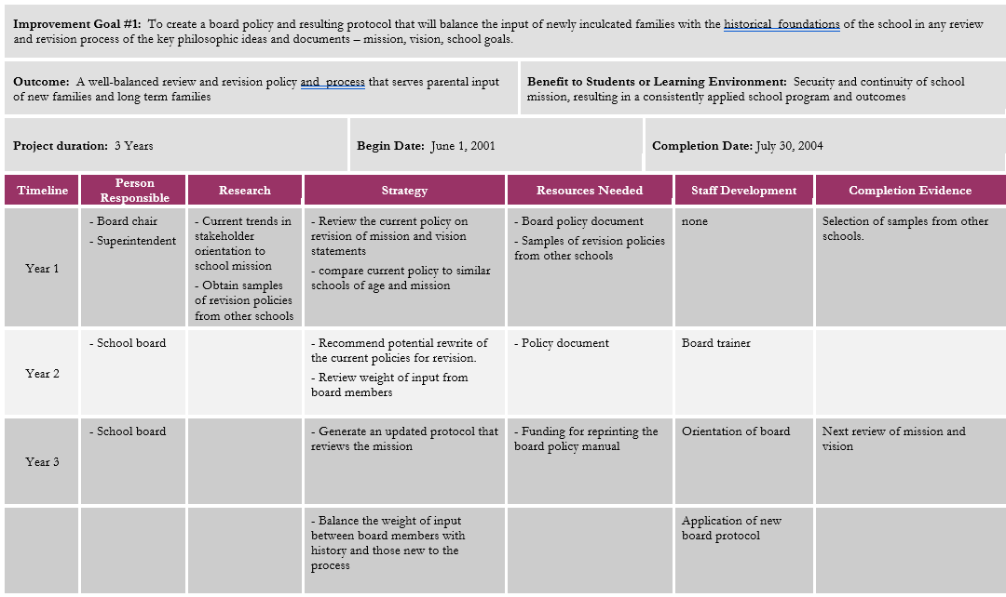
Notes:
There is no specific format for a CSIP, but there are essential elements. The document itself should be in a format that is usable for your team. Essential elements include: goals, time frame, action steps, person(s) responsible, resources needed, due date, evidence of progress, communication, and the expected schoolwide learning to result from this goal. You may find it helpful to include any research that is needed.

Slide 8
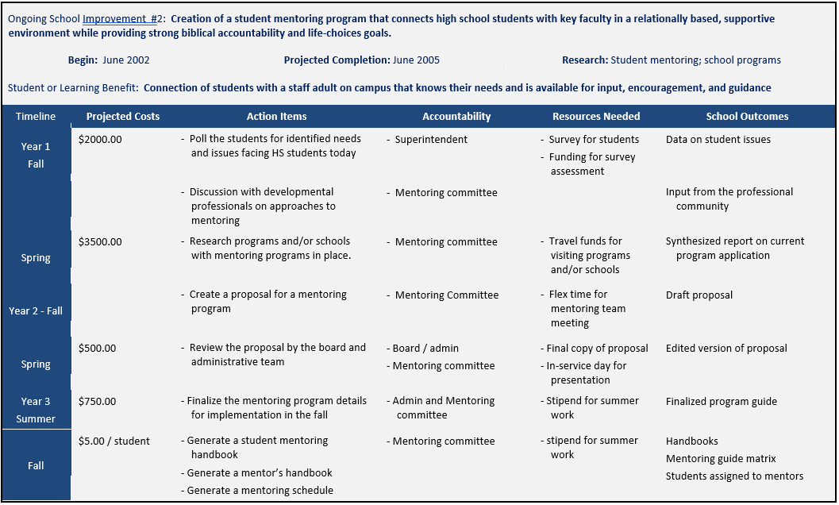
Notes:
This is another example of a CSIP, with a slightly different format but also containing the essential elements. Remember, the Improvement Goals will naturally be operationally focused when drawn from the major recommendations of an accreditation report. Any additional goals you choose to add should be operationally focused as well.

Slide 9
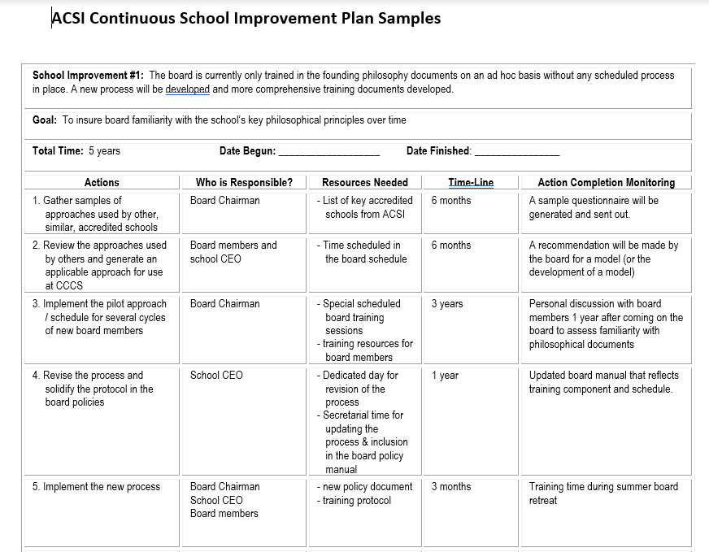
Notes:
Lastly, this third example is not as fancy, but you can see that it contains the essential elements. Just to reiterate, the purpose of having a CSIP is so that your school has a usable document to guide, focus, and provide structure for attaining your school improvement goals.

Slide 10
How?- Where do I begin the CSIP?
-Previous Accreditation Visit’s Major Recommendations
-Self Study
What if this is your first accreditation visit???
-Largely developed through your self study + any major recommendations that emerge from the visit.
Notes:
The continuous school improvement plan is really a document that ties together strategic work that you have already accomplished. Your CSIP will be evaluated during your on-site accreditation team visit. You will need to incorporate your previous accreditation visit’s major recommendations as this is the basis for your improvement. Additionally, while conducting your self study you may discover areas that are non-compliant and will want to add them to your CSIP prior to the team visit. But what about if this is your first accreditation visit? You, of course, wont have previous major recommendations to include in the development of this document. Instead, you should utilize the self study process to develop your CSIP prior to the team visit. You will then want to add any major recommendations that the team provides following their visit.

Slide 11
WHY?- Strategic Plan
-Provide Guidance and Direction
-Alignment with Mission and Vision
-Allocation of Resources—Budget
-Strengthening of Program
Notes:
Lets take a look at another critical document, the Strategic Plan. Did you notice that the “why’s” of a Strategic Plan mirror the Why’s of a Continuous School Improvement plan? That’s because the two work in tandem with each other. You will notice that the Why’s of a strategic plan deal with allocation of resources, much like the CSIP does, but with a greater focus on the budget. There actually are significant differences between the two plans, which we will discuss further.

Slide 12
WHAT?- Elements of the Strategic Plan
Focus on Viability Related Issues
-enrollment
-tuition
-student-faculty ratio
-compensation
-cash reserves
-fundraising
-governance
-facilities
*Often board-adopted strategic plans are referred to as a strategic financial plan—the financial components of the plan are critically important to the plan.
Notes:
A strategic plan, often referred to as a strategic financial plan, focuses on viability issues, with several of those issues listed here. As the board adopts this plan, it is the final authority of the board, along with partnership from the HOS, to fulfil the obligations of this plan.

Slide 13
HOW?- Where Do I Begin the Strategic Plan?
The board owns this process and the final document. Priorities for the Head of School are defined in this document and can actually formulate the job description for the Head of School: Implementing the Plan.
Develop Multi-Year goals for:
Enrollment
Fundraising
Tuition and Financial Aid
Facilities
Technology
Financial and Operational Ratios
Any elements from the CSIP that will require additional staffing or programmatic funding must be included in the Strategic Plan.
Notes:
As Head of School, you will be involved in the development and implementation of the Strategic Plan, but the Board is the final authority of the Strategic Plan. Your responsibilities, by and large, will be implementing the plan. As the strategic plan is developed, it should contain multi-year goals that speak to sustainability of the school, much like the examples listed above do. Be mindful to include elements from the CSIP that will require additional staffing or programmatic funding.

Slide 14
Can The CSIP and SP be Combined?
Based Upon Organizational Preference
-flexible
-annually updated
-guides annual priorities.
Can be unifying!
-effective planning processes
-communication of those processes and plan
-stakeholder buy-in
The resulting unity leads to greater effectiveness, efficiency, and financial support for the school.
Notes:
Whether there is one document or two depends on organizational preference. The resulting process should lead to a flexible, annually updated document(s) that guides annual priorities . Effective planning processes, communication of those processes and plans, along with stakeholder buy-in can bring substantial unity and focus to a school community. The resulting unity leads to greater effectiveness, efficiency, and financial support for the school.

Slide 15
Caution in Combining
! Board members may want to influence specific curricular decisions. (This is a faculty and administrative function.)
! Faculty may seek to influence things such as student-teacher ratios. (This is a board function.)
However, assuming both groups value broad input while respecting differing operational authority:
*Comprehensive plan
*Greater Focus
*Coordination by the head of school and the school community.
Notes:
It certainly is possible to combine or fully integrate a CSIP with a Strategic Financial Plan. However, there are two cautions to consider: Board members may want to influence specific decisions, such as curricular decisions, which really is a faculty and administrative function. Additionally, faculty may seek to have a greater influence on decisions such as student-teacher ratios, which really is a board function. However, if both groups are strong in valuing broad input while respecting differing operational authority, there lies tremendous value in combing the two: it builds a comprehensive plan, provides greater focus, and facilitates coordination by the head of school and the school community. Bottom line, is that schools can decide the best approach given their specific school leadership culture.

Slide 16
Accreditation Requirements:
Standard 8 in the REACH protocol requires a Continuous School Improvement Plan.
If a school is utilizing the ASP protocol, the ASP project stands as the CSIP.
Additional resources:
https://www.acsi.org/schoolaccreditationdocuments
Information for Fulfilling Specific Indicators
Notes:
In terms of accreditation requirements, Standard 8 in the REACH protocol requires a Continuous School Improvement Plan, but does not require a Strategic Financial Plan. If your school is utilizing the ASP protocol, the ASP project stands as the CSIP. You can find additional resources beyond this Power Point on the ACSI website at www.acsi.org/schoolaccreditationdocuments under the heading “information for fulfilling specific indicators.

Slide 17
2 Timothy 1:14
Guard, through the Holy Spirit who dwells in us, the treasure which has been entrusted to you.
Notes:
As we close our time together, I leave you with these words to encourage you: 2 Timothy 1:14
Guard, through the Holy Spirit who dwells in us, the treasure which has been entrusted to you.
May you be encouraged knowing that through your calling in stewarding all that you have been entrusted with, the Holy Spirit dwells with you.

