Slide 1

ASP Chair/Team Visit Toolkit
Resources for creating a positive experience

Slide 2
Thank You!
Thank you for your willingness to serve on an accreditation team visit. Your participation is a vital part of the accreditation process. Our prayer is that you will be richly blessed by this experience.
This toolkit is designed to be a supplement to the ASP Manual and the training sessions.
Hit the Control key while clicking on a link to open the webpage.

Slide 3
Chair/Team Training
ACSI has prepared video training for all Chairs/Teams. Please access this training HERE.
The Accreditation Director will hold a Q & A-Zoom twice a year in June and January to answer any questions you may have. Be on the lookout for those Zoom sessions.
Of course, as always, you can reach out directly to our office with any questions along the way.
Hit the Control key while clicking on a link to open the webpage.

Slide 4
Accreditation Visiting Team Documents
All accreditation documents for the ASP team are housed on our ACSI Main ASP Accreditation Website.
REACH Team Documents – you will need to access some of these documents as well including the Standards Checklist and the Indicator Ratings Spreadsheet – be sure to alert the school that they need to complete these documents.
There are additional resources on our NE Accreditation Supplemental Documents web page to help you as you serve as a team member.
I have highlighted some documents in this toolkit, but not all, so be sure to view all the documents on the website. Please be sure to always go to the website for the most current documents. If they are revised, there will be a revision date noted.
It is very important that you download, name, and save documents to your computer prior to completing them.

Slide 5
Writing an ASP Project Proposal
If the school is just transitioning into using ASP, please have them complete an ASP Project Proposal, due with the Transition Year School Report.
If the school is finishing an ASP cycle, having a Year 6 Visit, and continuing with another ASP Project, please discuss options for their next project at the team visit. They will follow up with the ASP consultant prior to submitting the next Project Proposal.
For more details about writing an ASP project proposal, please refer to Writing an ASP Project Proposal in your NE Accreditation Supplemental Documents web page

Slide 6
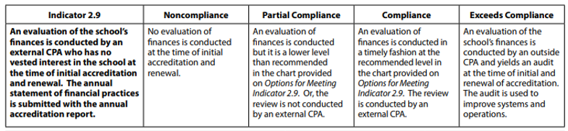
Indicator 2.9 Financial Review
Please note that Indicator 2.9 often gets missed by schools. The Chair should mention this at the pre-visit. There are several options to meet Indicator 2.9 based on the revenue of the school. Please reference Options for Meeting Indicator 2.9. This review should be based on the year prior to the team visit.
Also note: When reading through a financial review for 2.9, you may notice the following verbiage:
“Management has elected to omit substantially all disclosures required in financial statements prepared in accordance with cash basis of accounting.”
This DOES NOT mean that the school has withheld necessary documentation. What that means is that management decided to NOT have footnotes to their financial statements. The footnotes are typically seen as an integral part of the financial statements; however, for a small entity that is just having a cash basis compilation, it is acceptable that they are avoiding the footnotes. There isn’t necessarily anything that would be required to be disclosed in the footnotes that could not already be seen by in the financial statements.

Slide 7
REACH Documents the School Needs to Provide to the Team
Verification of Standards
Engage stakeholders in assessing the school’s compliance with all standards of accreditation, and provide the following REACH documents along with this report:
A completed, up-to-date REACH Standards Indicators Checklist;
A completed School Indicator Ratings Spreadsheet; and
A current School Certification Spreadsheet.
These 3 documents can be found on the REACH School Documents website.

Slide 8
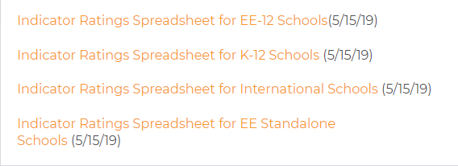
Indicator Ratings Spreadsheet
The school must use the Indicator Ratings Spreadsheet to rate itself on each of the indicators. The spreadsheet allows for 8 committee members to rate each indicator.
The spreadsheet will then give an average for each indicator, guiding the school’s response to their compliance level. Please be sure they have uploaded the spreadsheet into the Google Drive for the visiting team to review.
There are 4 options for the Indicator Ratings Spreadsheet found on our website under the Self-Study Forms and Documents tab. They should choose the one that reflects your school’s enrollment.

Slide 9
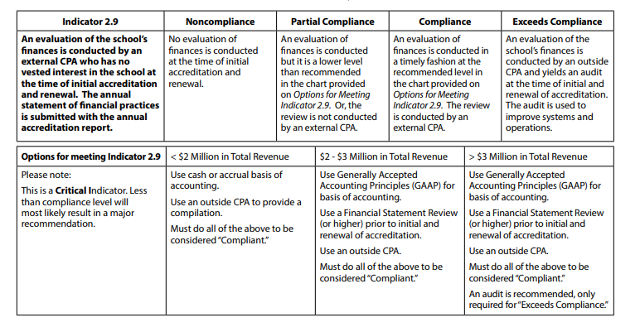
Indicator 2.9 – Financial Review
Indicator 2.9 often gets overlooked. Please note:
This is a critical indicator.
Options for meeting 2.9 based on school’s total revenue.
This review should be based on the year prior to the visit year.

Slide 10
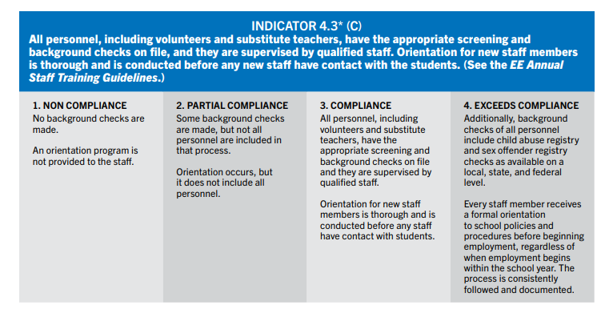
Indicator 4.3 – Background Checks
Indicator 4.3 often gets overlooked. Please note:
This is a critical indicator. The visit cannot take place unless the school is compliant with this.
Be sure they follow all applicable state, federal and local laws.
Documentation should be in an excel format so the team can easily review instead of having to look at each individual personnel record. You can find a sample spreadsheet that the school can tweak for their state’s needs.

Slide 11
Writing a Team Report
There are guidelines to writing the team report which must be followed. We want the report to be able to stand alone during the accreditation term so that anyone who picks it up (new administrator, chair, team member) can understand exactly what the team was trying to convey in the last visit.
Use the Formatting an ASP Team Report document found in our NE Accreditation Supplemental Documents web page under Visiting Team Documents tab to help you write the report in the correct ACSI format.
Be sure to give a DRAFT report to the school to review for factual accuracy before finalizing and sending it to the regional office.

Slide 12

Middle States Association (MSA) Representative Information
If you have been designated an MSA representative on the team roster you are responsible for completing the MSA Representative Visitor Standards Report that our office will submit to MSA following the visit. You can receive additional training from MSA directly via ZOOM. If you feel you need this training, please let the regional office know.
MSA documents can be found HERE. Please be sure to review these documents in advance of the team visit and reach out to our office if you have any questions.
In looking at the Standards for Accreditation, you will notice that a lot of them overlap with the ACSI standards. You are encouraged to take any narratives that apply to the ACSI report and use them in the MSA report. MSA wants you to include positive feedback as well as recommendations.
Should you feel that the school does not meet one of the MSA Standards, please reach out to Carol Aversa for assistance.
Do NOT send the MSA report directly to MSA. Our office will forward it with all the other team documents.

Slide 13
Following the Visit:
Complete the Team Report within 3 weeks of the visit
Send a Draft copy to the school to check for factual errors only
If EE was part of the visit, finalize the report in the ePlatform and email lynne_moyer@acsi.org when completed
Alert lynne_moyer@acsi.org when the ASP report is completed in the Google Drive
Finalize the MSA report in the Google Drive
Finalize the Ballot in Google Drive – if you would like me to send it electronically to the team to sign, send me the team’s recommendation and I will facilitate it from my end.
Be sure the Certification spreadsheet and/or EE Yearly Staff Profile are in the Google Drive
All team members/chairs should submit the Team Visit Evaluation form.
Once the evaluations are complete, our office will upload CEUs to your VPPs.
  Chairperson – 5 Educational CEUs
  Assistant Chair – 4 Educational CEUs
  Team Member – 3 Educational CEUs

Slide 14
Accreditation Checklist for Chairs
When Assigned as Chairperson (approx. 18 months prior) | Date Completed
Download the ASP Manual
Familiarize yourself with consultant responsibilities.
Guide school through completion of: The self-study documents Certification Spreadsheet/EE Yearly Staff Profile Indicator ratings spreadsheet Financial Review* ASP Transition Year School Report and ASP Project Proposal or the ASP Validation School Report *Prior to initial and renewal of accreditation
Review timeline and visit dates with Head of School (HOS) Back plan from team visit dates
Set initial pre-visit date with HOS
Review the school’s previous team report sent from the regional office
Review the school’s completed Standards Checklist Note any standards that are non-compliant Note any critical indicators that are non-compliant *Schools must have a minimum of 90% (27 based on REACH 2019) of critical indicators at the compliant level in order to have a team visit scheduled. If you have any concerns, please contact Carol Aversa, Accreditation Director. Refer to the Critical Indicators Checklist in our NE Accreditation Supplemental Documents web page under Team Docs Folder.
If dual accreditation, identify which supplements may be needed and who is the representative on the team (see team roster)

Slide 15
Accreditation Checklist for Chairs, cont.
12 Months Prior to Visit | Date Completed
Set dates with school for the team visit; notify regional office
Review training requirements for yourself and team
6 Months Prior to Visit | Date Completed
Conduct first visit to school and submit the Initial Pre-Visit Report to the regional office (found in the Team Docs folder). Review team member names with school Contact the regional office if the school does not approve the list Discuss status of any standard or critical indicator issues Notify the regional office if there are areas of non-compliance
Set date for a second pre-visit
Communicate with team

Slide 16
Accreditation Checklist for Chairs, cont.
3 Months Prior to Visit | Date Completed
Provide the following information to the team members Prior visiting team report Completed REACH Standards Indicators Checklist Completed School Indicator Ratings Spreadsheet Current School Certification Spreadsheet/EE Yearly Staff Profile Review training that they will need to complete
Conduct second visit to school (or Zoom conference) and send confirmation to the regional office that the school is well prepared for the visit Review deadline for report submission to team Review team logistical needs (private meeting room) School accreditation workroom for team (supplies needed) Develop schedule for visit
Communication with the visiting team Review school timeline and preliminary visit schedule Confirm travel plans for each team member Review the Values and Ethics Statement with the team Provide the template for the report Provide samples of recommendations
8 Weeks Prior to Visit | Date Completed
Confirm minimal requirements have been met (if not met previously)
Submit Verification for Team Visit Readiness form to regional office – PLEASE NOTE EVIDENCE MUST BE SEEN
Develop schedule for visit. Sample can be found in the NE Accreditation Supplemental Documents web page
Once you receive final documents from school, forward them to the team members
Set up a Zoom meeting with team members to review documents and give instructions on how to be prepared for the visit
Set up secure DropBox or Google Drive so that team members can begin narratives for their sections and can peer edit. Instruct team members to complete as much as possible prior to the visit

Slide 17
Accreditation Checklist for Chairs, cont.
3 Weeks Prior to the Visit | Date Completed
Complete team training and complete the Team Training Verification Form. Be sure your team members have done the same
Share final schedule with team and HOS
During the Visit
Oversee the report writing process Use Classroom Observation Tool for Accreditation (COTA) for several observations and submit COTA to Academic Services via email as instructed (it may be used to acknowledge a gap that the project is addressing as well as establish compliance with indicators) Complete Team Report Have team members complete and submit expense report to school Chair and team members complete team evaluations
Gather daily opinions of the team members regarding achieving accreditation NOTE: The Chairperson MUST contact Carol Aversa, Accreditation Director (prior to sharing the report with the HOS) if less than a full term of accreditation is being recommended by the team)
Concluding Activities of the Visit
Review and edit, as a team, all sections of the report
Engage the team in coming to a consensus on any major recommendations that might be needed
Provide copy of draft report to HOS to review for factual errors (if report isn’t complete at the visit, email after the visit prior to submitting to the regional office as final
Present final oral report to school representatives at conclusion of visit using the Exit Report PowerPoint Template. If dually accrediting with MSA, find a dual Exit Power Point here.
Submit all documents to the regional office Team Report School Report Certification Spreadsheet/EE Yearly Staff Profile MSA Report (if applicable) Ballot for Accreditation
Submit a REACH Team Visit Evaluation Form electronically

Slide 18

Additional Resources
Additional Resources in the NE Accreditation Supplemental Documents web page
Instructions for setting up a Zoom meeting
Initial Pre-Visit Report
Commendation and Recommendation Examples
Too Prescriptive Examples (what not to do when writing recommendations)
Team Chair Google Drive Information
Written Policy Requirements
Critical Indicator Checklist
Supplemental Info Regarding Standard 2
ASP Project Proposal Sample
Guiding Questions for ASP Visits
ASP 7-Year Term Flowchart

Slide 19
CAROL AVERSA, M.Ed.
Director of Accreditation | Northeast
––––––––––––––––––––––––––––––––––––
Association of Christian Schools International
Mobile:484-330-1934
ACSI.org
Lynne Moyer
Administrative Assistant, Accreditation | Northeast
719-867-5277

