Slide 1
ASP School Toolkit
Resources for creating a positive experience

Slide 2
You have chosen the ASP protocol out of a desire to strengthen your school through the challenge of action research and discovering the impact on your student outcomes. Our prayer is that you continue to be richly blessed by this experience.
This toolkit is designed to be a supplement to the ASP Manual and the training sessions.
Hit the Control key while clicking on a link to open the webpage.

Slide 3
Training Options
School Coordinator Training to help you through the ASP process is available for both Transition to ASP visits and ASP Validation Visits.
Online Training Resources (Scroll to the bottom under Accreditation by School Progress (ASP) Training). You may also feel free to watch one or more of the Self-Study Process training for Schools as some of it may be helpful to you.
Suggested training
School Training 7 – Certification and Waivers
ePlatform School Self-Study Training (for EE programs only if not included in the ASP project)
The Accreditation Director will hold a Q & A-Zoom twice a year in June and January to answer any questions you may have. Be on the lookout for those Zoom sessions.
Of course, as always, you can reach out directly to our office with any questions along the way.

Slide 4
Accreditation School Documents
All accreditation documents for the ASP School are housed on our ACSI Main ASP Accreditation Website.
REACH Team Documents – you will need to access some of these documents as well including the Standards Checklist and the Indicator Ratings Spreadsheet.
There are additional resources on our NE Accreditation Supplemental Documents web page to help you as you prepare for your visit.
I have highlighted some documents in this toolkit, but not all, so be sure to view all the documents on the website. Please be sure to always go to the website for the most current documents. If they are revised in any way there will be a revision date noted.
It is very important that you download, name, and save documents to your computer prior to completing them.

Slide 5
Writing an ASP School Report
If your school is just transitioning into using ASP, please complete the ASP Transition Year School Report.
If your school is finishing an ASP cycle and having a Year 6 Visit, please complete the ASP Validation School Report.
ASP Project Proposal
For more details about writing an ASP project proposal, please refer to Writing an ASP Project Proposal on our NE Accreditation Supplemental Documents web page.

Slide 6
REACH Documents Needed
As indicated on the ASP School Report you will need to submit the following.
Verification of Standards
Engage stakeholders in assessing the school’s compliance with all standards of accreditation, and provide the following REACH documents along with this report:
A completed, up-to-date REACH Standards Indicators Checklist;
A completed School Indicator Ratings Spreadsheet; and
A current School Certification Spreadsheet.
These 3 documents can be found on the REACH School Documents website.

Slide 7
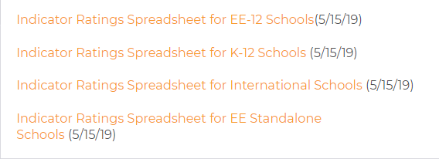
Indicator Ratings Spreadsheet
The school must use the Indicator Ratings Spreadsheet to rate itself on each of the indicators. The spreadsheet allows for 8 committee members to rate each indicator. You may add more columns depending on the number of committee members.
The spreadsheet will then give an average for each indicator, guiding your response to your compliance level. Please upload the spreadsheet into the Google Drive for the visiting team to review.
There are 4 options for the Indicator Ratings Spreadsheet found on our website under the Self-Study Forms and Documents tab. Choose the one that reflects your school’s enrollment.

Slide 8
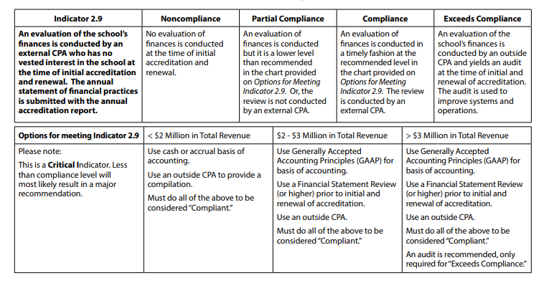
Indicator 2.9 – Financial Review
Indicator 2.9 often gets overlooked. Please note:
This is a critical indicator.
Options for meeting 2.9 based on school’s total revenue.
This review should be based on the year prior to the visit year.

Slide 9
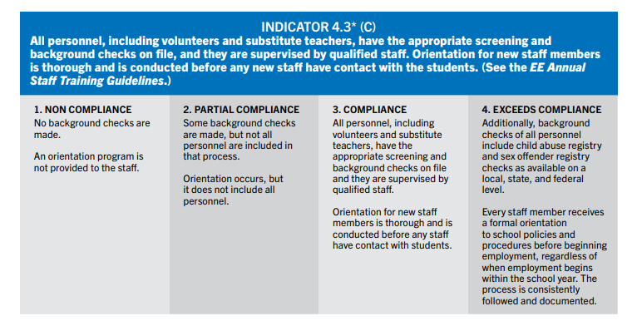
Indicator 4.3– Background Checks
Indicator 4.3 often gets overlooked. Please note:
This is a critical indicator. The visit cannot take place unless the school is compliant with this.
Be sure to follow all applicable state, federal and local laws.
Documentation should be in an excel format so the team can easily review instead of having to look at each individual personnel record. You can find a sample spreadsheet that you can tweak for your state’s needs.

Slide 10
ePlatform Information (ONLY if your school is accrediting an EE program)
Schools with an attached EE program may choose to have their EE program included in their ASP project or do a separate REACH self-study for EE only. Standalone EE programs cannot do ASP.
As a school seeking accreditation for your EE program along with your ASP, you have an account in the ePlatform, which is our online portal where you will access the school self-study and finalize the EE portion of your report.
Please note that we recommend the school complete their work in a Word document or other word processing form and then copy and paste the information to the ePlatform when complete. We have provided a Self-Study Report Template on our main school accreditation website for this purpose.
The use of Google Drive is helpful as it allows for collaboration on the school report.
Be sure to reference the Quick Reference Guide to Self-Study on the ePlatform.

Slide 11
Hosting a Team Visit
A team of peer Christian schoolteachers and administrators will visit the school to either:
During a transition visit, assist the school in transitioning to the ASP protocol, assess readiness to implement the ASP project proposal and validate REACH standards and indicators
During a validation visit, validate the ASP project in Year 4 (or 6 if you are dually accredited with MSA) and validate REACH standards and indicators.
The school is responsible for all travel and hosting expenses of the visiting team members.

Slide 12
Verification for Team Visit Readiness
The Readiness Checklist needs to be completed by the chairperson 8 weeks prior to the team visit and turned into our office. This review will make final determination of the school’s readiness to host the visit.
The following items must be met for the visit to be held:
All previous Major Recommendations have been met
Evidence has been seen to substantiate that the following indicators are at compliance:
2.11 – compliance with applicable local, state and federal laws
3.7 – nondiscrimination statement published and evident
4.3 – appropriate screening and background checks for all personnel
6.1 – comprehensive written security and crisis management plan
6.7 – policies for child safety and staff conduct; training in reporting responsibilities
6.10 – legal standards for fire protection, sanitation and transportation met
Certification levels at 80% for staff and 100% for admin by visit date
No more than 10% of critical indicators are below compliance level
Verification for Team Visit Readiness Checklist

Slide 13
What to expect during the team visit
The visiting team will spend time interviewing board members, administrators, faculty and staff, as well as parents and students regarding the ASP project. Classroom observations will take place to see the project in action. The tone of the interviews and classroom visits is collegial and not inspective.
Items that are helpful for a visiting team:
Compilation of each teachers’ names, grade levels and assignments, schedule, and room numbers
Facilities Map
Wi-Fi Network and Password Key
Security Passes/Keys/ID’s
Reserved Parking (if parking is an issue)

Slide 14
Middle States Association (MSA) Information
If you are dually accredited with MSA or wish to be, be sure to let the regional office know as well as MSA.
You should expect an Application for Evaluation for MSA, to be sent in February prior to your upcoming visit. If you do not receive it, please reach out to MSA for a copy. This application is what starts the process of having you placed on MSA’s Commission meeting agenda.

Slide 15
Following the Visit:
The Chair will provide you with a copy of a draft report to review for factual errors
The school ASP report and the visiting team report will be submitted to the ACSI NE Regional Commission for its upcoming meeting
Following the meeting of the commission, the school will be notified regarding its accreditation status.
Accredited schools receive an ACSI certificate signifying the accreditation of the school.
An Annual Report is required each fall.
Accredited schools must maintain membership.
Accredited schools must maintain open communication with their ACSI office.

Slide 16
Accreditation Checklist for Administrators
18 Months Prior to Team Visit | Date Completed
Download the ASP Manual
Visit our training website and review the ASP Training Resources
Assemble your self-study teams
Familiarize yourself with the Critical Indicators that must be at compliant level for the visit to take place. Reference the Critical Indicator Checklist on our regional accreditation webpage.
Start working on the Financial Review. Refer to Options for Meeting Indicator 2.9. (Under Information for Fulfilling Specific Indicators Tab)
Set initial pre-visit date with chairperson.
Familiarize yourself with either Transition Year Report and ASP Project Proposal OR ASP Validation Report depending on your visit type
12 Months Prior to Team Visit | Date Completed
Set dates with chairperson for the team visit; notify accreditation office
Request any needed assistance from your chairperson while conducting your school’s self-study.

Slide 17
Accreditation Checklist for Admins, cont.
6 Months Prior to the Visit | Date Completed
Set date for second pre-visit with chairperson
Make arrangements for transportation, lodging, meals and a meeting room for team.
Prepare supplementary data: curriculum guides, board policy manual, handbooks, etc. for review. Reference the Curriculum Mapping and CSIP samples on our NE Accreditation Supplemental Documents web page.
4 – 6 Months Prior to the Visit | Date Completed
Complete the following: REACH Standards Indicators Checklist School Indicator Ratings Spreadsheet School Certification Spreadsheet (be sure to review the sample and the FAQ document) Financial Review If accrediting EE program – EE Yearly Staff Profile
Submit the above documents to your chair and the accreditation office.

Slide 18
Accreditation Checklist for Admins, cont.
2 – 3 Months Prior to Visit | Date Completed
Complete the School Validation or Transition Report
Work with chair to develop schedule for visit. Sample can be found on the NE Accreditation Supplemental Documents web page .
Your Chairperson will confirm that the minimal requirements have been met if not met previously by completing the Verification for Team Visit Readiness Checklist.
3 weeks Prior to Visit | Date Completed
Confirm reservations for team members
During the Visit
Avail self to team
Concluding Activities of the Visit
Review draft copy of team report for confirmation of factual accuracy.
Complete and submit REACH Team Visit Evaluation electronically.
ACSI only schools have a 5-year cycle. Schools with dual MSA accreditation have a 7year cycle. See 7 Year Term ASP
Flowchart on our NE Regional Accreditation page.

Slide 19
Additional Resources
Additional Resources on the NE Accreditation Supplemental Documents web page
• Supplemental certification information
• ASP Validation Committee Planners
• ASP Project Proposal Sample
• ASP Validation Report Sample
• 7 Year ASP Flowchart
• Curriculum Mapping Sample
• Critical Indicator Checklist

Slide 20
CAROL AVERSA, M.Ed.
Director, Eastern Division | Northeast Director of Accreditation
––––––––––––––––––––––––––––––––––––
Association of Christian Schools International
Office: 719-867-6181
carol_aversa@acsi.org
Lynne Moyer
Administrative Assistant, Eastern Division | NE Accreditation
Office: 719-867-5277
lynne_moyer@acsi.org

