Slide 1

REACH Chair/Team Toolkit
Resources for Creating a Positive Experience
REACH

Slide 2
Thank You!
Thank you for your willingness to serve on an accreditation team visit. Your participation is a vital part of the accreditation process. Our prayer is that you will be richly blessed by this experience.
This toolkit is designed to be a supplement to the handbook and training sessions.
Hit the Control key while clicking on a link to open the webpage.

Slide 3
Chair/Team Training
ACSI has prepared video training for all Chairs/Teams. Please access this training HERE.
The Accreditation Director will hold a Q & A-Zoom twice a year in June and January to answer any questions you may have. Be on the lookout for those Zoom sessions.
Of course, as always, you can reach out directly to our office with any questions along the way.
Hit the Control key while clicking on a link to open the webpage.

Slide 4
Accreditation Visiting Team Documents
All accreditation documents for the visiting team are housed on our Team Accreditation Documents website.
I have highlighted some documents in this PowerPoint but not all, so be sure to view all the documents on the website, which will be updated if any revisions are made. Always go to the website for the most current documents and train your school to do the same. The documents are divided into the following sections:
Manuals
Pre-Visit Documents
Visit Documents
ePlatform Documents
Post-Visit Documents
PLEASE NOTE: In the summer of 2020, ACSI revised several indicators in Standard 4 to provide more flexibility in meeting the indictors outlining personnel qualifications. These changes are effective immediately. You can find more information here.
Download all documents to your computer prior to completing them.

Slide 5
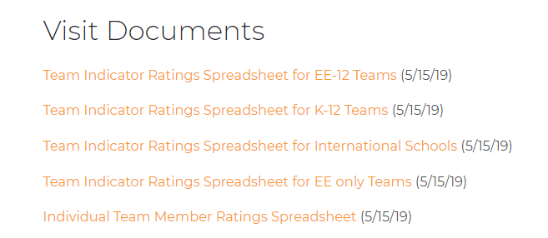
Indicator Ratings Spreadsheet
The TEAM must use the Indicator Ratings Spreadsheet to rate the school on each of the indicators. (See Chair Training 5 – The Team Report for instructions)
The team members should complete the Individual Team Member Ratings Spreadsheet while doing the initial reading of the school’s self-study prior to the visit. Your rating is a “best guess” which will be adjusted once the team is on site and evaluating collaboratively.
There are 4 options for the Indicator Ratings Spreadsheet found on our website under the Self-Study Forms and Documents tab. Chose the one that reflects the school’s enrollment.

Slide 6
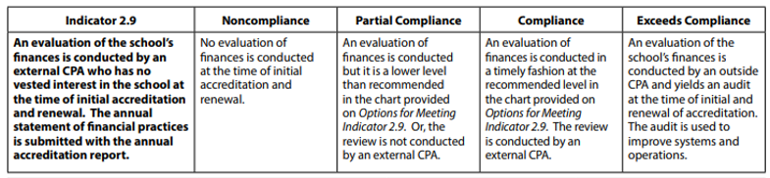
Indicator 2.9 Financial Review
Please note that Indicator 2.9 often gets missed by schools. The Chair should mention this at the pre-visit. There are several options to meet Indicator 2.9 based on the revenue of the school. Please reference Options for Meeting Indicator 2.9. This review should be based on the year prior to the team visit.
Also note: When reading through a financial review for 2.9, you may notice the following verbiage:
“Management has elected to omit substantially all disclosures required in financial statements prepared in accordance with cash basis of accounting.”
This DOES NOT mean that the school has withheld necessary documentation. What that means is that management decided to NOT have footnotes on their financial statements. The footnotes are typically seen as an integral part of the financial statements; however, for a small entity that is just having a cash basis compilation, it is acceptable that they are avoiding the footnotes. There isn’t necessarily anything that would be required to be disclosed in the footnotes that could not already be seen in the financial statements.

Slide 7
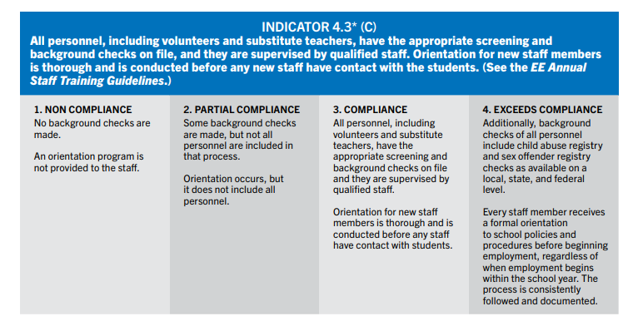
Indicator 4.3 – Background Checks
Indicator 4.3 often gets overlooked by schools. Please note:
This is a critical indicator. The visit cannot take place unless the school is compliant with this.
Be sure they are following all applicable state, federal and local laws.
Documentation should be in an excel/spreadsheet format so the team can easily review it instead of having to look at each individual personnel record. You can find a sample spreadsheet that the school can tweak for their state’s needs.

Slide 8
End of Day Goals for a Standard REACH Visit
Sunday
  Standard overviews are written in red
  Team Indicator Ratings Spreadsheet completed
Monday
  Edit/adjust/add to standard overview
  Begin writing majors for areas that are 2’s and 4’s
  (stretch goal) – someone edit and turn the overview to blue
Tuesday
  If the overview is ready to edit write “READY to EDIT”
  Someone edits and turns the overview to blue
  All other areas turned to blue
  All commendations and recommendations drafted and edited (red to blue)
  Major commendations and recommendations copied from standards commendations and recommendations
Wednesday
  Report completed – all turned to green
  Ballot completed
  Exit PP completed

Slide 9
Quick Tips for Writing Commendations and Recommendations
If a Critical Indicator is non-compliant or partial compliant, the team MUST develop a major recommendation that cites that indicator.
If a Critical Indicator is non-compliant or partial compliant, the standard rating will either be partial or non-compliant. Note: If a visiting team determines, based on the REACH Rubrics Manual, that the school has fulfilled the substance of the compliant-level wording of the critical indicator in question, and is lacking only in ancillary evidence (e.g., documentation, training, regular review, etc.), the team may allow the standard rating to remain compliant provided that the rest of the indicators within the standard warrant such a rating. However, if multiple critical indicators within a standard fall under this exception, the standard rating will either be partial or non-compliant.
Any indicator that is partially compliant or non-compliant should receive a recommendation under that standard. These should not automatically be a major recommendation.
If there are multiple standards below the compliance level, the team should consider a negative status, a midterm visit, or a progress report for the school.
Indicators 2.11, 3.7, 4.3, 6.1, 6.7, 6.10 must be at the compliance level for a visit to occur. If during a visit any of these are not compliant, a major recommendation with a supplementary report is required, or the school’s accreditation may be put on a negative status until all these indicators are at the compliance level.
Major Recommendations are always based on the fact that a school is not meeting a standard of accreditation or a critical indicator.

Slide 10
Quick Tips for Writing Commendations and Recommendations, Cont
Indicators that are rated a 4 should receive a commendation. Critical Indicators that are rated a 4 should be bumped up to a major commendation.
There is no need to recreate a major commendation or recommendation. Simply copy and paste the standard commendation or recommendation that you wish to elevate to a major. Make the text bold under the standard if it was elevated to a major. If you choose to combine two commendations or recommendations into one major, cite both indicators.
Recommendations and Commendations should include both a Statement and Description.
  The Statement for a commendation should be a one-sentence statement of fact. The Description should be a brief description of what the team saw, and it explains why the commendation was warranted.
  The Statement for a Recommendation should start with an active verb specifying what the school should do the more fully meet the standard indicator without being prescriptive.
The Description should be a brief description of what the team saw, and it explains why the recommendation is warranted.
*Read Carefully the Chair and Team Member Handbook, paying careful attention to Appendix A – Writing Commendations and Recommendations and Appendix B – Writing the Standard Overview.
*Read Carefully Formatting a Team Report for ACSI for more detailed instructions on writing the Team Report.

Slide 11
Sample Recommendation
Provide a well-documented biblical basis for all courses consistent with developing a biblical worldview which includes supportive biblical integration concepts embedded in the guides/maps so that true integration is evident rather than just correlation. Develop a biblical basis for outside sourced courses/credits according to ACSI’s Guidelines for Accepting Credits from Other Sources. (Indicators 5.1, 5.2, 7.5)
Christian Academy has developed curriculum maps that guide lesson planning and student learning. Biblical integration was not consistent in maps, during observations, or in sample lesson plans. Further development of biblical integration concepts should follow. All the necessary components of the curriculum are developed but must now be integrated to assure curricular and biblical integration success. Training for how to develop a biblical worldview and how to integrate those concepts throughout units and lessons, including outside sourced courses/credits, must be an ongoing component of the staff professional development program. (Self-study; interviews with teachers and administration)

Slide 12
Sample Commendation
Each staff member has a clear testimony of faith in Christ, has signed the school's statement of faith, and endorses the school's code of ethics/lifestyle statement. In addition to the signed documents, staff members exemplify a passion for Christ, for students, and for Christ-centered educational processes. (Indicator 4.1)
The school board members, students, and parents affirm that the teachers at Christian Academy are passionate about helping students develop and grow their relationships with Christ. The teachers work together to make sure that the culture of the school is positive and encourages Christlike care and concern among the students. (Parent interviews; school board interviews; student interviews; teacher interviews; classroom observations; review of faculty/staff records)

Slide 13

Middle States Association Representative Information (MSA)
If you have been designated an MSA representative on the team roster you are responsible for completing the MSA Representative Visitor Standards Report that our office will submit to MSA following the visit. You can receive additional training from MSA directly via ZOOM. If you feel you need this training, please let the regional office know.
MSA documents can be found HERE. Please be sure to review these documents in advance of the team visit and reach out to our office if you have any questions.
In looking at the Standards for Accreditation, you will notice that a lot of them overlap with the ACSI standards. You are encouraged to take any narratives that apply to the ACSI report and use them in the MSA report. MSA wants you to include positive feedback as well as recommendations.
Should you feel that the school does not meet one of the MSA Standards, please reach out to Carol Aversa for assistance.
Do NOT send the MSA report directly to MSA. Our office will forward it with all the other team documents.

Slide 14
Following the Team Visit (within 3 weeks)
Complete the Team Report
Send a Draft copy to the school to check for factual errors
Finalize document in the ePlatform and email Lynne_moyer@acsi.org to alert that it is completed.
Finalize the MSA report in the Google Drive
Finalize the Ballot in the Google Drive – if you would like me to send it electronically to the team to sign, send me the team’s recommendation and I will facilitate it from my end.
Save a copy of the Certification Spreadsheet in the Google Drive
All team members and the Chair complete a visit Evaluation Form
Once the evaluations are complete, our office will upload CEUs to your VPPs.
  Chairperson – 5 Educational CEUs
  Assistant Chair – 4 Educational CEUs
  Team Member – 3 Educational CEUs

Slide 15
Accreditation Timeline
When Assigned as Chairperson | Date Completed
Review the candidacy or previous team report for the school (found in Team Google Drive)
Review the school’s completed Standards Checklist Note any standards that are non-compliant Note any critical indicators that are non-compliant *Schools must have a minimum of 90% of critical indicators at the compliant level in order to have a team visit scheduled. If you have concerns please contact Carol Aversa, Accreditation Director at carol_aversa@acsi.org. Refer to the Critical Indicator Checklist on our NE Accreditation Supplemental Documents web page
Review timeline and visit dates with school administrator Back plan from team visit dates
Plan a faculty and steering committee orientation visit to the school A tele-conference is optional if this is a renewal visit
If dual accreditation, identify which supplements may be needed and who is the representative on the team (see team roster)
Establish a communication update schedule with the school
Guide school through completion of the self-study which includes the following: Certification Spreadsheet/EE Yearly Staff Profile (revised in summer 2020) Continuous School Improvement Plan Indicator Ratings Spreadsheet Financial Review Using the ePlatform Schools should submit these docs to the chair at least 8 weeks prior to the team visit
Review training requirements

Slide 16
Accreditation Checklist for Chairs
12 Months Prior to Visit | Date Completed
Confirm the visit dates and team members with the regional office
6 Months Prior to Visit | Date Completed
First meeting with the school administrator Review team member names with school Contact the regional office if the school does not approve the list Discuss the status of any standard or critical indicator issues Notify the accreditation office if there are areas of non-compliance Request that the school tells you when one standard has been completed so that you can review it to be sure all the elements are there, and they are ready to proceed to the next standard.
Meet or conduct video conference with steering committee Review status of self-study report and evidences Request preliminary copy of self-study Agree on how evidences are made electronically available to team Review visit dates and general schedule Establish the date for the self-study to be completed and submitted Set up date for second pre-visit Reference Required Documentation by Standard and Written Policy Requirements on our NE Accreditation Supplemental Documents web page
Complete Initial Pre-Visit Report (found on the NE Accreditation Supplemental Documents web page ) and send to regional office. Include one of the following statements: The school is well prepared for the visit as scheduled The school may not be prepared for the visit as scheduled The school will not be prepared for the visit as scheduled
Welcome and provide school information to the team members Confirm with team members their reporting assignments

Slide 17
Accreditation Checklist for Chairs, cont.
4 to 6 Months Prior to Visit | Date Completed
Provide the following documents to your team members Prior Visiting Team Report or Candidacy Report Completed REACH Standards Indicators Checklist Completed School Indicator Ratings Spreadsheet Current School Certification Spreadsheet/EE Yearly Staff Profile (revised in summer 2020)
3 Months Prior to Team Visit | Date Completed
Conduct second consulting visit or video conference with the school Review of the online access to the self-study, evidences, and data Ensure that the self-study, evidences, and data are virtually complete Review deadline for submission to chair and team Review team logistical needs (accommodations during visit with meeting room) School accreditation workroom for team (internet, projector, supplies, privacy, etc.) Develop schedule for visit. Sample can be found in the Chair/Team Handbook Confirm with the regional office that the school is prepared for the visit.
Communication with the visiting team Review school timeline and preliminary visit schedule Confirm travel plans for each team member Review the Values and Ethics Statement with the team Provide the template for the report Provide sample of commendations and recommendations

Slide 18
Accreditation Checklist for Chairs, cont.
2 Months Prior to Team Visit | Date Completed
Communicate with the school leadership and steering committee Review the status of the self-study Confirm that all critical indicators are in compliance Remind the school of the deadline for having the complete self-study, evidences and data posted If the deadline is missed the visit may be cancelled Discuss the visiting team schedule in detail. Sample can be found on our regional webpage General schedule, interviews, group meetings, observations, exit meeting Review the team logistics for the visit Team accommodations and meals Team workroom needs Team travel arrangements Team travel plans and expense reimbursements Communicate with the visiting team members Chair provides a draft of introductory sections of the report Review of schedule and writing assignments for each member Review of interview schedule for team as a group and individual members Ensure that each standard writer has appropriate interviews scheduled Have them complete the Individual Team Member Ratings Spreadsheet
Confirm minimal requirements are met Submit Verification for Team Visit Readiness report to regional office (found on Team Documents webpage) PLEASE NOTE: EVIDENCE MUST BE SEEN

Slide 19
Accreditation Checklist for Chairs, cont.
8 Weeks Prior to Team Visit | Date Completed
Ensure that the self-study, evidences and data are complete and posted for team access Contact the school immediately if the self-study, evidences and data are not posted Notify the accreditation office if documents are not ready Discuss any last details of the visit with the school Review the final team schedule with the school Confirm the team logistics for accommodations, travel, workroom, etc.
Communicate with the visiting team. Plan a thorough team orientation with video conference Ensure that all team members have accessed the ePlatform and the documents Team member initial rating for each indicator for all standards Review each of the Critical Indicators Team members provide draft of assigned standards narratives Draft commendations and recommendations Review with individual team member if draft does not meet quality writing or accreditation policy Confirm final travel arrangements and other logistics
Familiarize team with report template that will be used to write the team report prior to uploading to the ePlatform
Use the secure Google drive the ACSI gives you access to so that the team members can begin narratives for their sections and can peer edit. Instruct team members to complete as much as possible prior to visit
3 Weeks Prior to Team Visit | Date Completed
Complete team training and send verification to accreditation office
Confirm that your team members have completed training

Slide 20
Accreditation Checklist for Chairs, cont.
During the Visit | Date Completed
Approach the visit as the most prepared member of the team
Conduct a tour of the school as soon as possible and review the details of the schedule
Plan an organizational and orientation time (90 min) Ethics and professional distance and demeanor for the team Validation of the school self-study, evidences, and data Provide objective insights with clear concise writing Cooperate with the chair and all the team in reaching consensus Emphasis on following the schedule and being on time for all meetings
As you meet with stakeholders you can use these guiding questions to get started (found on our NE Accreditation Supplemental Documents web page
Review the team report document Follow the report template without variation Set daily goals for the team Provide extra support to team members as needed Establish a daily debrief session Manage the team for effectiveness and efficiency Review goal accomplishments, issues, and concerns daily
Conduct a team review of each report section as it is completed, including the Team Indicator Ratings Spreadsheet. Refer to Required Documentation by Standard and Written Policy Requirements in the NE Accreditation Supplemental Documents web page
Gather daily opinions of the team members regarding achieving accreditation NOTE: The Chairperson MUST contact Carol Aversa, Accreditation Director (prior to sharing the report with the HOS) if less than a full term of accreditation/reaccreditation is being recommended by the team.

Slide 21
Accreditation Checklist for Chairs, cont.
Concluding Activities of the Visit | Date Completed
Review and edit, as a team, all sections of the report
Engage the team in coming to a consensus on major recommendations, and recommendations to the Commission Establish a final rating for each of the indicators using the Team Indicator Ratings Spreadsheet to share with the school, if so desired by the school Ensure that major recommendation are standards based Include a minority report if necessary
Complete supplementary documents needed by partner organizations
Use the appropriate ballot(s) for team recommendation
Prepare an exit report using the template found on the Team Documents webpage. Briefly review major commendations and recommendation Note the team accreditation recommendation to the Commission Remind the school that the Commission makes the final decision on accreditation School invites attendees to the exit report meeting
Meet with the school administrator/leadership and review the entire report
Team members submit expense report and submit to school
Conduct, with the team, an exit report meeting with school staff and guests Present brief exit report using the provided template Remind the attendees that there will not be discussion or questions about the report Clarify that the visiting team is a recommending group, not decision-making group

Slide 22
Accreditation Checklist for Chairs, cont.
Concluding Team Meeting | Date Completed
Remind team that the report and recommendation is confidential
Remind the team they will be asked to evaluate the chair electronically
Distribute reimbursement checks to the team
Thank the team for their service
Following Team Visit | Date Completed
Complete final editing of the report within 3 weeks of visit on the ePlatform Review for clarity, proper grammar, and punctuation Review for consistency with ACSI report guidelines
Provide a copy to the school administrator and team members for review, watermark as “confidential.”
Submit the following documents to the regional office within 3 weeks after the visit: Ballot for Accreditation Certification Spreadsheet/EE Yearly Staff Profile MSA Report (if applicable) Finalize the report in the ePlatform and mark the team report complete Submit a REACH Team Visit Evaluation Form electronically

Slide 23

Additional Resources
Additional Resources in the NE Accreditation Supplemental Documents web page
Instructions for setting up a Zoom meeting
Initial Pre-Visit Report
Commendation and Recommendation Examples
Too Prescriptive Examples (What not to do when writing recommendations)
Team Chair Google Drive Information
Required Documentation by Standards
Written Policy Requirements
Critical indicator Checklist
Guiding Questions for REACH Visit
Supplemental Info Regarding Standard 2

Slide 24
CAROL AVERSA, M.Ed.
Director, Eastern Division | Northeast Director of Accreditation
––––––––––––––––––––––––––––––––––––
Association of Christian Schools International
Office: 719-867-6181
carol_aversa@acsi.org
Lynne Moyer
Administrative Assistant, Eastern Division | NE Accreditation
Office: 719-867-5277
lynne_moyer@acsi.org

