Slide 1
REACH School Toolkit
Resources for Creating a Positive Experience
REACH 2019

Slide 2
Congratulations!
We are praying for you as you begin (or continue) your accreditation journey with ACSI.
This Toolkit has been designed to be a companion to the School Administrator’s Handbook to help guide you through your team visit.
A consultant/chairperson assigned to the school has been trained in the many components of the ACSI accreditation program. This person is a resource to you through the entire self-study process.
All the expenses incurred by the consultant are paid by the school.
Hit the Control key while clicking on a link to open the webpage.

Slide 3
School Coordinator Training
ACSI has prepared video training for all School Coordinators in the Self-Study process. Please access this training HERE.
The Accreditation Director will hold a Q & A-Zoom twice a year in June and January to answer any questions you may have. Be on the lookout for those Zoom sessions.
Of course, as always, you can reach out directly to our office with any questions along the way.
Hit the Control key while clicking on a link to open the webpage.

Slide 4
Accreditation School Documents
All accreditation documents for the school are housed on our School Documents Website: https://www.acsi.org/accreditation-certification/accreditation-for-schools/reach-school-accreditation-documents
I have highlighted some in this document but not all, so be sure to view all the documents on the website.
The website has the most up to date documents. If any documents are revised, they will be updated with a revision date noted. Always go to the website for the most current documents. The documents are divided into the following sections:
Applications and Manuals
Self-Study Forms and Documents
ePlatform Documents
Information for Fulfilling Specific Indicators – Be sure to read these carefully as they have a lot of helpful information
Post-Visit Forms and Documents
EE Accreditation Documents
Supporting Documents for EE
PLEASE NOTE: In the summer of 2020, ACSI revised several indicators in Standard 4 to provide more flexibility in meeting the indictors outlining personnel qualifications. These changes are effective immediately. You can find more information here.
It is very important that you download documents to your computer prior to completing them.

Slide 5
Writing a Self-Study
The school must organize the school staff and other stakeholders into self-study groups to complete the process. Each of the standards is carefully reviewed using the indicators and rubrics to guide the preparation of an accurate, complete, well-written report. It must rate itself on each of the indicators, write a concluding narrative regarding the standard, and compile a list of evidence which the school used to rate the indicator.
An EE program will additionally use the EE Evidence Guide for REACH Indicators for standards 3, 5 and 6.

Slide 6
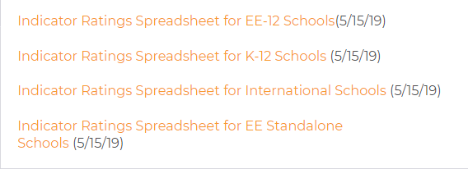
Indicator Ratings Spreadsheet
The school must use the Indicator Ratings Spreadsheet to rate itself on each of the indicators. The spreadsheet allows for 8 committee members to rate each indicator. You may add more columns depending on the number of committee members.
The spreadsheet will then give an average for each indicator, guiding your response to your compliance level. Please upload the spreadsheet into the ePlatform for the visiting team to review.
There are 4 options for the Indicator Ratings Spreadsheet found on our website under the Self-Study Forms and Documents tab. Chose the one that reflects your school’s enrollment.

Slide 7
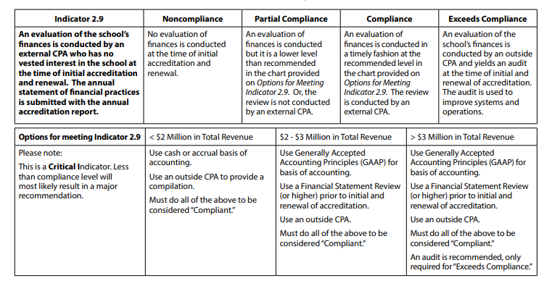
Indicator 2.9 – Financial Review
Indicator 2.9 often gets overlooked. Please note:
This is a critical indicator.
Options for meeting 2.9 based on school’s total revenue.
This review should be based on the year prior to the visit year.

Slide 8
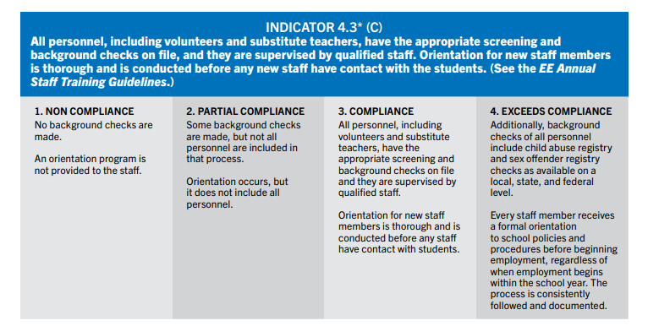
Indicator 4.3 – Background Checks
Indicator 4.3 often gets overlooked. Please note:
This is a critical indicator. The visit cannot take place unless the school is compliant with this.
Be sure to follow all applicable state, federal and local laws.
Documentation should be in an excel format so the team can easily review instead of having to look at each individual personnel record. You can find a sample spreadsheet that you can tweak for your state’s needs.

Slide 9
Hosting a Team Visit
After completing the self-study, a team of peer Christian schoolteachers and administrators will visit the school. The school is responsible for all travel and hosting expenses of the visiting team members.
The purpose of the team visit is to verify the integrity of the self-study and observe that the standards are being met.
The team members will prepare a list of commendations and recommendations for each section of the self-study.

Slide 10
Verification for Team Visit Readiness
The Readiness Checklist needs to be completed by the chairperson 8 weeks prior to the team visit and turned into our office. This review will make final determination of the school’s readiness to host the visit.
The following items must be met for the visit to be held:
All previous Major Recommendations have been met
Evidence has been seen to substantiate that the following indicators are at compliance:
2.11 – compliance with applicable local, state and federal laws
3.7 – nondiscrimination statement published and evident
4.3 – appropriate screening and background checks for all personnel
6.1 – comprehensive written security and crisis management plan
6.7 – policies for child safety and staff conduct; training in reporting responsibilities
6.10 – legal standards for fire protection, sanitation and transportation met
Certification levels at 80% for staff and 100% for admin by visit date
No more than 10% of critical indicators are below compliance level
Verification for Team Visit Readiness Checklist

Slide 11
What to expect during the team visit
The visiting team will spend time interviewing students, parents, faculty, board members and support staff. There will be scheduled interviews with leadership within the school. Classroom observations will take place to overview the academic rigor, classroom management, student engagement, teacher-student relationships and pedagogy in the school. The tone of the interviews and classroom visits is collegial and not inspective.
Items that are helpful for a visiting team:
Compilation of each teachers’ names, grade levels and assignments, schedule, and room numbers
Facilities Map
Wi-Fi Network and Password
Security Passes/Keys/ID’s
Reserved Parking (if parking is an issue)

Slide 12
Middle States Association (MSA) Information
If you are dually accredited with MSA or wish to be, be sure to let the regional office know as well as MSA.
You should expect an Application for Evaluation for MSA, to be sent in February prior to your upcoming visit. If you do not receive it, please reach out to MSA for a copy. This application is what starts the process of having you placed on MSA’s Commission meeting agenda.

Slide 13
Following the Team Visit:
The Chair will provide a draft copy of the team report for you to review for factual errors.
The school self-study report and the visiting team report will be submitted to the ACSI NE Regional Commission for its upcoming meeting.
Following the meeting of the commission, the school will be notified regarding its accreditation status.
Accredited schools receive an ACSI certificate signifying the accreditation of the school.
An annual report is required each fall.
Accredited schools must maintain membership.
Accredited schools must maintain open communication with their ACSI office.

Slide 14
Accreditation Checklist for Administrators
18 Months Prior to Team Visit | Date Completed
Download the School Administrators Handbook.
Download the REACH Standards Manual.
Visit our Training Website and review the School Training Resources.
Familiarize yourself with the Critical Indicators that must be at compliant level for the visit to take place. Reference the Critical Indicator Checklist on our NE Accreditation Supplemental Documents web page .
Start working on the Financial Review. Reference Options for Meeting Indicator 2.9 under the Information for Fulfilling Specific Indicators tab.
Find and download all the self-study documents.
Set first pre-visit date with chairperson.
Familiarize yourself and your team with the ePlatform.
Assemble Steering Committee: Chairperson, timelines, subcommittees. Reference the Self-Study Committee Planner for REACH visit.
Start working on the self-study using the REACH Self-Study Word Template prior to uploading to the ePlatform.

Slide 15
Accreditation Checklist for Administrators
12 Months Prior to Team Visit | Date Completed
Set dates with chairperson for team visit and communicate those dates to the accreditation office.
Request any needed assistance from your chairperson while conducting your school’s self-study.
6 Months Prior to Team Visit | Date Completed
Set date for second pre-visit with chairperson.
Make arrangements for transportation, lodging, meals and meeting room for team.
Prepare supplementary data: curriculum guides, board policy manual, handbooks, etc., for review.
4 to 6 Months Prior to Team Visit | Date Completed
Start working on finalizing the following: REACH Standards Indicator Checklist School Indicator Ratings Spreadsheet EE Only EE-12 K-12 Current School Certification Spreadsheet (be sure to review the sample and the FAQ document) Financial Review If accrediting EE program – EE Yearly Staff Profile (updated in 2020)
Upload the above documents to the ePlatform at least 8 weeks prior to the visit.

Slide 16
Accreditation Checklist for Administrators
2 to 3 Months Prior to Team Visit | Date Completed
Have second pre-visit with chairperson (may be video conference)
8 Weeks Prior to Team Visit | Date Completed
Your Chairperson will confirm that the minimal requirements have been met if not met previously by completing the Verification for Team Visit Readiness Checklist. Evidence MUST be seen by the chair.
Upload all information into the ePlatform and mark it as complete.
Work with chair to finalize schedule for visit.
3 Weeks Prior to Team Visit | Date Completed
Confirm reservations for team members.
During/After the Visit
Avail self to team.
Review draft copy of team report for confirmation of factual accuracy.
Complete and submit REACH Team Visit Evaluation electronically.

Slide 17
Additional Resources
Additional Resources on the NE Accreditation Supplemental Documents web page
• Difference between CSIP and Strategic Plan
• REACH Accreditation Self-Study Committee Planner
• Curriculum Mapping Sample
• CSIP Samples
• Required Documentation by Standard
• Written Policy Requirements
• Critical Indicators Checklist

Slide 18
CAROL AVERSA, M.Ed.
Director, Eastern Division | Northeast Director of Accreditation
––––––––––––––––––––––––––––––––––––
Association of Christian Schools International
Office: 719-867-6181
carol_aversa@acsi.org
Lynne Moyer
Administrative Assistant, Eastern Division | NE Accreditation
Office: 719-867-5277
lynne_moyer@acsi.org

