Slide 1



SEGMENT 6:
SELF STUDY REPORT
SCHOOL COORDINATOR TRAINING

Slide 2

INITIAL SELF-STUDY TIPS
  Change in Focus from Descriptive Narratives to Concise Analysis
  Use Google Docs or Shared Folder to do All Writing and Editing

Slide 3
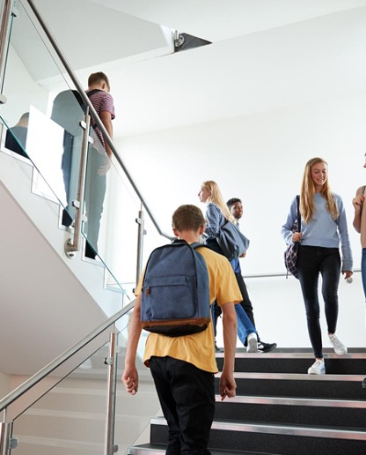
SELF-STUDY
  Introduction/ Profile
  Standards and Indicators Assessment
  Domain Information
  Reflective Questions
  Conclusion
  Prioritized Goals for Improvement (Reference the Indicator)
  Reference School Coordinator Handbook Page 18 for Details

Slide 4
SEGMENT 6:
SELF STUDY REPORT
SCHOOL COORDINATOR TRAINING

