Slide 1

Expected Student Outcomes – Part II
Assessment
Erin Wilcox, EdD
Assistant Vice President
Academic Services ACSI
Notes:
Hi, my name is Erin Wilcox. I’m the Assistant Vice President for Academic Services at ACSI.
Welcome, participants. This is the second webinar in a two part series about Expected Student Outcomes. If you have not watched the first part, you may want to go back and watch part one as this builds on those concepts.

Slide 2
Objectives:
Understand the need for assessment of ESOs, both academic and non-academic
Become better equipped to assess ESOs, especially non-academic ESOs
Learn to effectively use non-academic assessment data in school improvement
Work with examples and practice our skills
Look at a few examples of an “Assessment Report” (ways you might compile and communicate this to constituents)
Notes:
For this webinar, the objectives are:

Slide 3
Recap from Part I
ESOs - “concepts, dispositions, or skills that students ought to know, be, or be able to do as a result of a given educational experience.”
(Swaner and Erdvig, 2018)
Once defined, these academic and non-academic outcomes will drive strategic planning, hiring decisions, budgeting, program planning, curriculum choices, teacher evaluation, and a host of other decisions.
Notes:
Let’s begin by recapping Part 1 – Expected Student Outcomes
The definition of ESOs is…

Slide 4
ESOs
Strategic Planning
Hiring
Budgeting
Curriculum Choices
Teacher Evaluation
Program Planning
Notes:
In the Accreditation Protocol, Indicator 1.3 says that foundational documents such as the Expected Student Outcomes will be used as integrative, coordinating and examining devices throughout all aspects of the programs, operations, and curriculum. If they are well-developed, that is what ESOs are intended to be.

Slide 5

Objectives or Outcomes?
Notes:
Let’s stop for a minute a clarify why we need to identify these outcomes. Why aren’t having OBJECTIVES enough?
I was recently working with some folks who were getting these two concepts confused. I’m sure many of us have. Is it important to figure out the difference?
I think so, and I’ll tell you why.
Objectives are your good intentions…your goals and objectives….what you would like to cover and want your students to learn.
The Outcomes are what you expect to see on the other end to verify that they actually learned what you expected. The proof or evidence of that learning.
To give you an illustration, I’ll move it out of education for a minute.
When we sign up for a service like house painting, we have a reason or a purpose for that (goals and objectives). We could list all the things we hope to get out of that service. The house will be more beautiful, fit better into the neighborhood, get a make-over, look better if we decide to sell it someday, etc. However, the outcomes that the painter is willing to commit to are things that he can be measured on. He will complete the work in a certain period of time, with certain paint, to a certain quality of workmanship, for a certain amount of money, etc. He may not be able to address all the objectives you have in mind. You will need to agree on some measurable criteria to determine if he has produced the desired outcomes. Those may not all be quantitative. There may be some that are qualitative such as neatness, coverage of the paint, etc.
In the end, you two agree on the contract. You value his services. You agree on the outcomes and the metrics you will use to determine if he has met the criteria. Your objectives are driving those decisions but all that you two can agree on are the outcomes that he can produce.
Apply this nowto the world of education and specifically Christian schooling. Parents have many, many objectives for their children and these are the reasons they bring them to our Christian schools. We fill our promotional material with aspirational statements that say that we can perform miracles with these children and parents all apply that to what they are looking for in their own child. Then 12 or 13 years of schooling happens and we ask ourselves or the parents ask us if we accomplished those “objectives.” But most of us never agree on the measurable outcomes. One family would like to have seen X, Y and Z and another would have preferred A, B, and C. One student was more adept at this coming in, and another at that. All those objectives come back to haunt us in a way because we never defined what they would look like in a student who had accomplished those as “outcomes.” We might never have agreed to the terms of the contract and so by default, we sort of took on everyone’s expectations without any way to declare what the finished product should look like. There was no target to shoot for.
With the first webinar, we learned to define our Expected Student Outcomes.
They are broad, general categories that help you figure out what a graduate would look like, if you were able to define that by outcomes after 12-13 years at your school.

Slide 6

Expected Student Outcomes
Well prepared academically to succeed at the next level
Understands and demonstrates Christian faith (personal commitment, spiritually discerning, Christlike character)
Have a biblical worldview, (understand God’s view of man, other worldviews, apply apologetic skills)
Well-balanced, emotionally healthy living (relates to others being made in God’s image, and self-discipline)
Has a heart for missions and serving others, (reaches out to the world, understands other cultures)
Life-long learner and critical thinker (value intellectual pursuit, make wise decisions, creative)
Ethical, person of moral integrity, (pursue justice)
Good steward of all that God has given us, (finances, world, work)
Notes:
Let me give you an example.
This slide shows you 8 categories from a school that I worked with, who was working through the process of determining their ESOs. This is a rough draft from them, part way through the process, when they had narrowed down areas they felt they needed to cover.
I put these eight ideas up on large sheets of butcher paper and we left one blank piece of paper in case there were ideas that didn’t fit under any of these categories (or Outcomes).
Then I had the teachers put sticky notes with competencies that they would want to see, if the broad categories (or Outcomes) became a reality in the lives of students.
My point is NOT to give you a finished list. I want to give you an idea of the process I went through with them so that you could do something similar with your school if you wanted. It is important to make the list YOURS!
Well prepared academically to succeed at the next level
Understands and demonstrates Christian faith (personal commitment, spiritually discerning, role of Holy Spirit, Christlike character)
Have a biblical worldview, (understand God’s view of man, other worldviews, apply apologetic skills)
Well-balanced, emotionally healthy living, relates to others being made in God’s image (self-discipline)
Has a heart for missions and serving others, (reaches out to the world, understands other cultures)
Life-long learner and critical thinker (value intellectual pursuit, make wise decisions, creative)
Ethical, person of moral integrity, (pursue justice)
Good steward of all that God has given us, (finances, world, work)
You may choose to combine these differently than this school did. The exact Outcomes a school choose will reflect their priorities.

Slide 7
Competencies
More measurable competencies, or subpoints to list
Example #1: Well prepared academically to succeed at the next level
Effectively communicates (writing, speaking, listening, reading), and produces quality work
Utilizes technology responsibly and effectively for research and presentations
Example #2 – Demonstrates well-balanced, emotionally healthy living (relates to others being made in God’s image)
Works together in teams
Relates well to others (treats others with respect)
Notes:
The next step was to move to competencies. These are more measurable. They relate to the big ideas on the previous page. There are often several competencies under each outcome.
For example, this school decided that under the outcome of being well prepared academically, the students needed to
1) Effectively communicates (writing, speaking, listening, reading), and produces quality work
Utilizes technology responsibly and effectively for research and presentations
Something about “is well prepared for standardized academic testing”
In many schools, this is one of the longer ones since academics is a core outcome of a school.
In another example, Demonstrates well-balanced, emotionally healthy living (relates to others being made in God’s image)
1) Works together in teams
Relates well to others (treats others with respect)
As a school, finish your list of the general outcomes, then fill it out with more measurable competencies. That will set you up for success.

Slide 8
Finalized list of ESOs
Fits on one page
Has 8 or fewer major categories
Has subpoints/competencies that are more measurable than the general categories (resemble SMART Goals)
Includes academic and non-academic areas
Is general enough to apply to all grade levels
Includes spiritual formation among other characteristics
Reflect your school’s mission, Core Values, ENDS
Theme - optional
Notes:
I recommend the following:
Fits on one page
Has 8 or fewer major categories (some have only 3-4) “Love the Lord your God with all your heart, your soul, your mind, and Love your neighbor as yourself.” Matthew 22
Has subpoints/competencies that are more measurable than the general categories (resemble SMART Goals)
Includes academic and non-academic areas
Is general enough to apply to all grade levels
Includes spiritual formation among other characteristics
Reflect your school’s mission, Core Values, ENDS (established by the board)
Theme/acrostic – optional (easier to remember, don’t sacrifice meaning/content)
Example – Dalat’s Flagships (nautical theme) scholarship, discipleship, citizenship, relationship (more memorable, certainly optional)

Slide 9
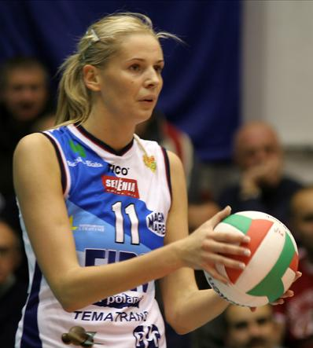
Why do we have assessments?
We want to know if
we are accomplishing
our goals.
This applies to
non-academic
assessments as well.
Notes:
Now we are ready to move to assessment of ESOs.
Why is this so important? We want to know if we are accomplishing our goals.
Too often we just teach the next year’s information because it comes up in the next grade. We are so guilty of that as educators! It isn’t because we have assessed these students and we know that they need all of this or more of this and less of that. We treat them as a group and even though we assess them, we don’t really do anything substantial with the information.
Let’s contrast that to a test that you have had to take that really matters if you pass or fail. That could be a driving license test, a foreign language test or a scuba diving certification. If you don’t pass, you don’t drive, you don’t get the job, or you don’t go scuba diving on that coveted vacation. During your limited number of lessons that you are paying for, you don’t want to be treated like one of a group…instructed on material that you already know and missing concepts that you need to know. You want to be assessed regularly, and then have the instruction adjusted to your strengths and weaknesses, designed to help you pass the final test or demonstrate the competencies needed.
If we want to be good at accomplishing our Outcomes…we need to assess our accomplishment of those Outcomes and adjust instruction accordingly.
Think about the volleyball server. She can continue to hit the ball to the same place on each serve.
She could be serving it to the best player on the other team and loses the point.
She could learn from that, assess the situation and make adjustments.
Her coach also has a role in this process helping her to see where she needs to make those adjustments.
If she watches the game, listens to her coach, and adjusts her practice based on what has happened with other serves, she may know who is the weaker serve receiver, not as skilled, who might not be paying attention, and then she has a greater chance of winning the point and keeping her serve, Possibly winning the game!
In education, we do assessment because it matters to us that students are learning and accomplishing the intended student outcomes we have established for them. It helps us increase our teaching effectiveness and intervene when individual students struggle and are unable to meet the learning goals. We are accountable to those who have commissioned us to this work and to those who are entrusting us with their children. Assessment analyzes the evidence of student learning and allows us to make the necessary adjustments to ensure that each individual (and therefore all students make it to the finish line) by graduation.
These are words usually said about academic student accomplishments such as math and reading, science and social studies. We rarely apply this same rigor to our non-academic outcomes. However, I would challenge you to think about why many of our families pay dearly to put their children in our Christian schools. They want the college prep academics, yes, but they want them in an environment where they can also get those non-academic outcomes.

Slide 10
How do you know if you are accomplishing your non-academic Outcomes?
“We look at our Outcomes when we do curriculum planning so I assume we are meeting them.”
“I do a lot of professional development with the teachers.”
“I have students leading Bible studies and volunteering to participate in chapels. Some alumni come back and tell us they do well in college.”
“Kids seem to like Bible and I know the kids. I can just tell they’re doing fine.”
“My teachers are still doing the same things that they’ve done for 20 years but the students aren’t the same anymore. I wish we could measure them.”
Notes:
How do you know if you are accomplishing your non-academic Outcomes?
I did my dissertation on how schools assess their non-academic outcomes and in the process, I asked people at ACSI schools this question. READ ANSWERS>
These are typical answers I got…
Let’s look at these five answers…
First two – problems because they are a focus only on inputs…not the Outcomes. They really don’t know if they are hitting the mark, just good intentions.
Third and fourth are the typical – feedback is anecdotal – They are saying “I have a few examples that show me this or that…therefore all of them must be good. That validates the approach we’re using, doesn’t it?” The problem with this is that geniuses can come from the slums. Or the more common phrase…even a broken clock is right twice a day. The fact that these things are true may not be to your credit at all. It may be parents, church, etc. and not be the effect of your school.
The fifth one is just as sad (READ IT)…the administrator knows that the instruction/materials have become outdated because the audience has changed. He just doesn’t know what to do about it. He doesn’t have the tools/data to make good decisions.
If you think these are anomalies, they are not. These typified the answers I received.

Slide 11
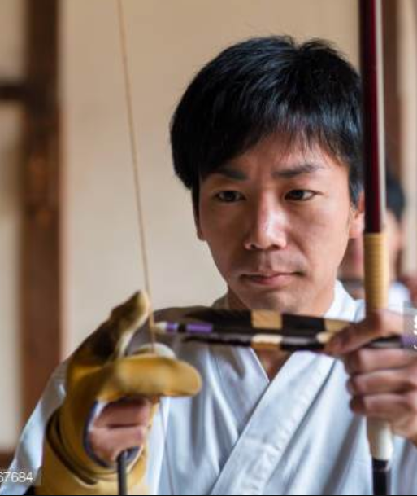
Notes:
Let’s think about answers #1 and 2 again…Those were all about the inputs.
In the case of an archer, what if we only looked at the bow, the string, the grip, the force, and the archer?
What would we not know? His aim? The distance? The force he put into the shot. We wouldn’t know if that was the right arrow for this distance and that target in these weather conditions. We would never know if all that preparation and excellent equipment actually accomplished anything. We wouldn’t know if he hit the target.
And so it is when schools say that they invest it all in the input side of things. They do a great job hiring good teachers, working with them in professional development…that’s important…but if they never check to see if the outcomes that are desired are actually accomplished, what do they have? We don’t know if they’ve hit the target!

Slide 12

Notes:
Study this picture for a moment.
What can this archer learn from analyzing their work?
Adjusting their aim, strength of their release, arrows selected? How they were standing, holding the bow? All of that affects whether they were able to hit the target, and then, with adjustments, the bulls-eye.
This is similar to what we do when we actually look at how students measure up on the Outcomes.

Slide 13
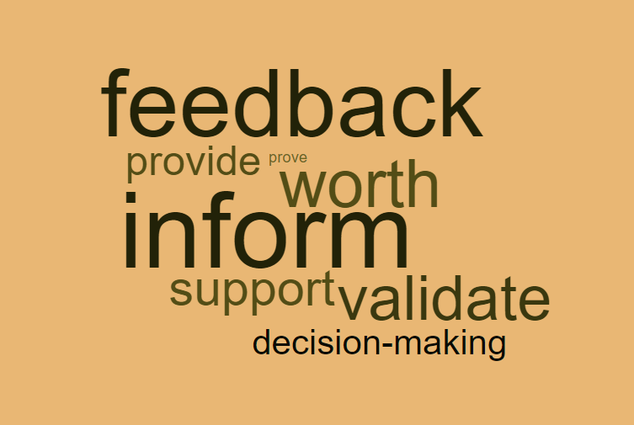
Purpose of Assessment
Notes:
Purpose of assessment is to:
Inform
Validate accomplishments
Provide feedback
Support and direct decision-making
Overall…with a purpose of improving instruction

Slide 14
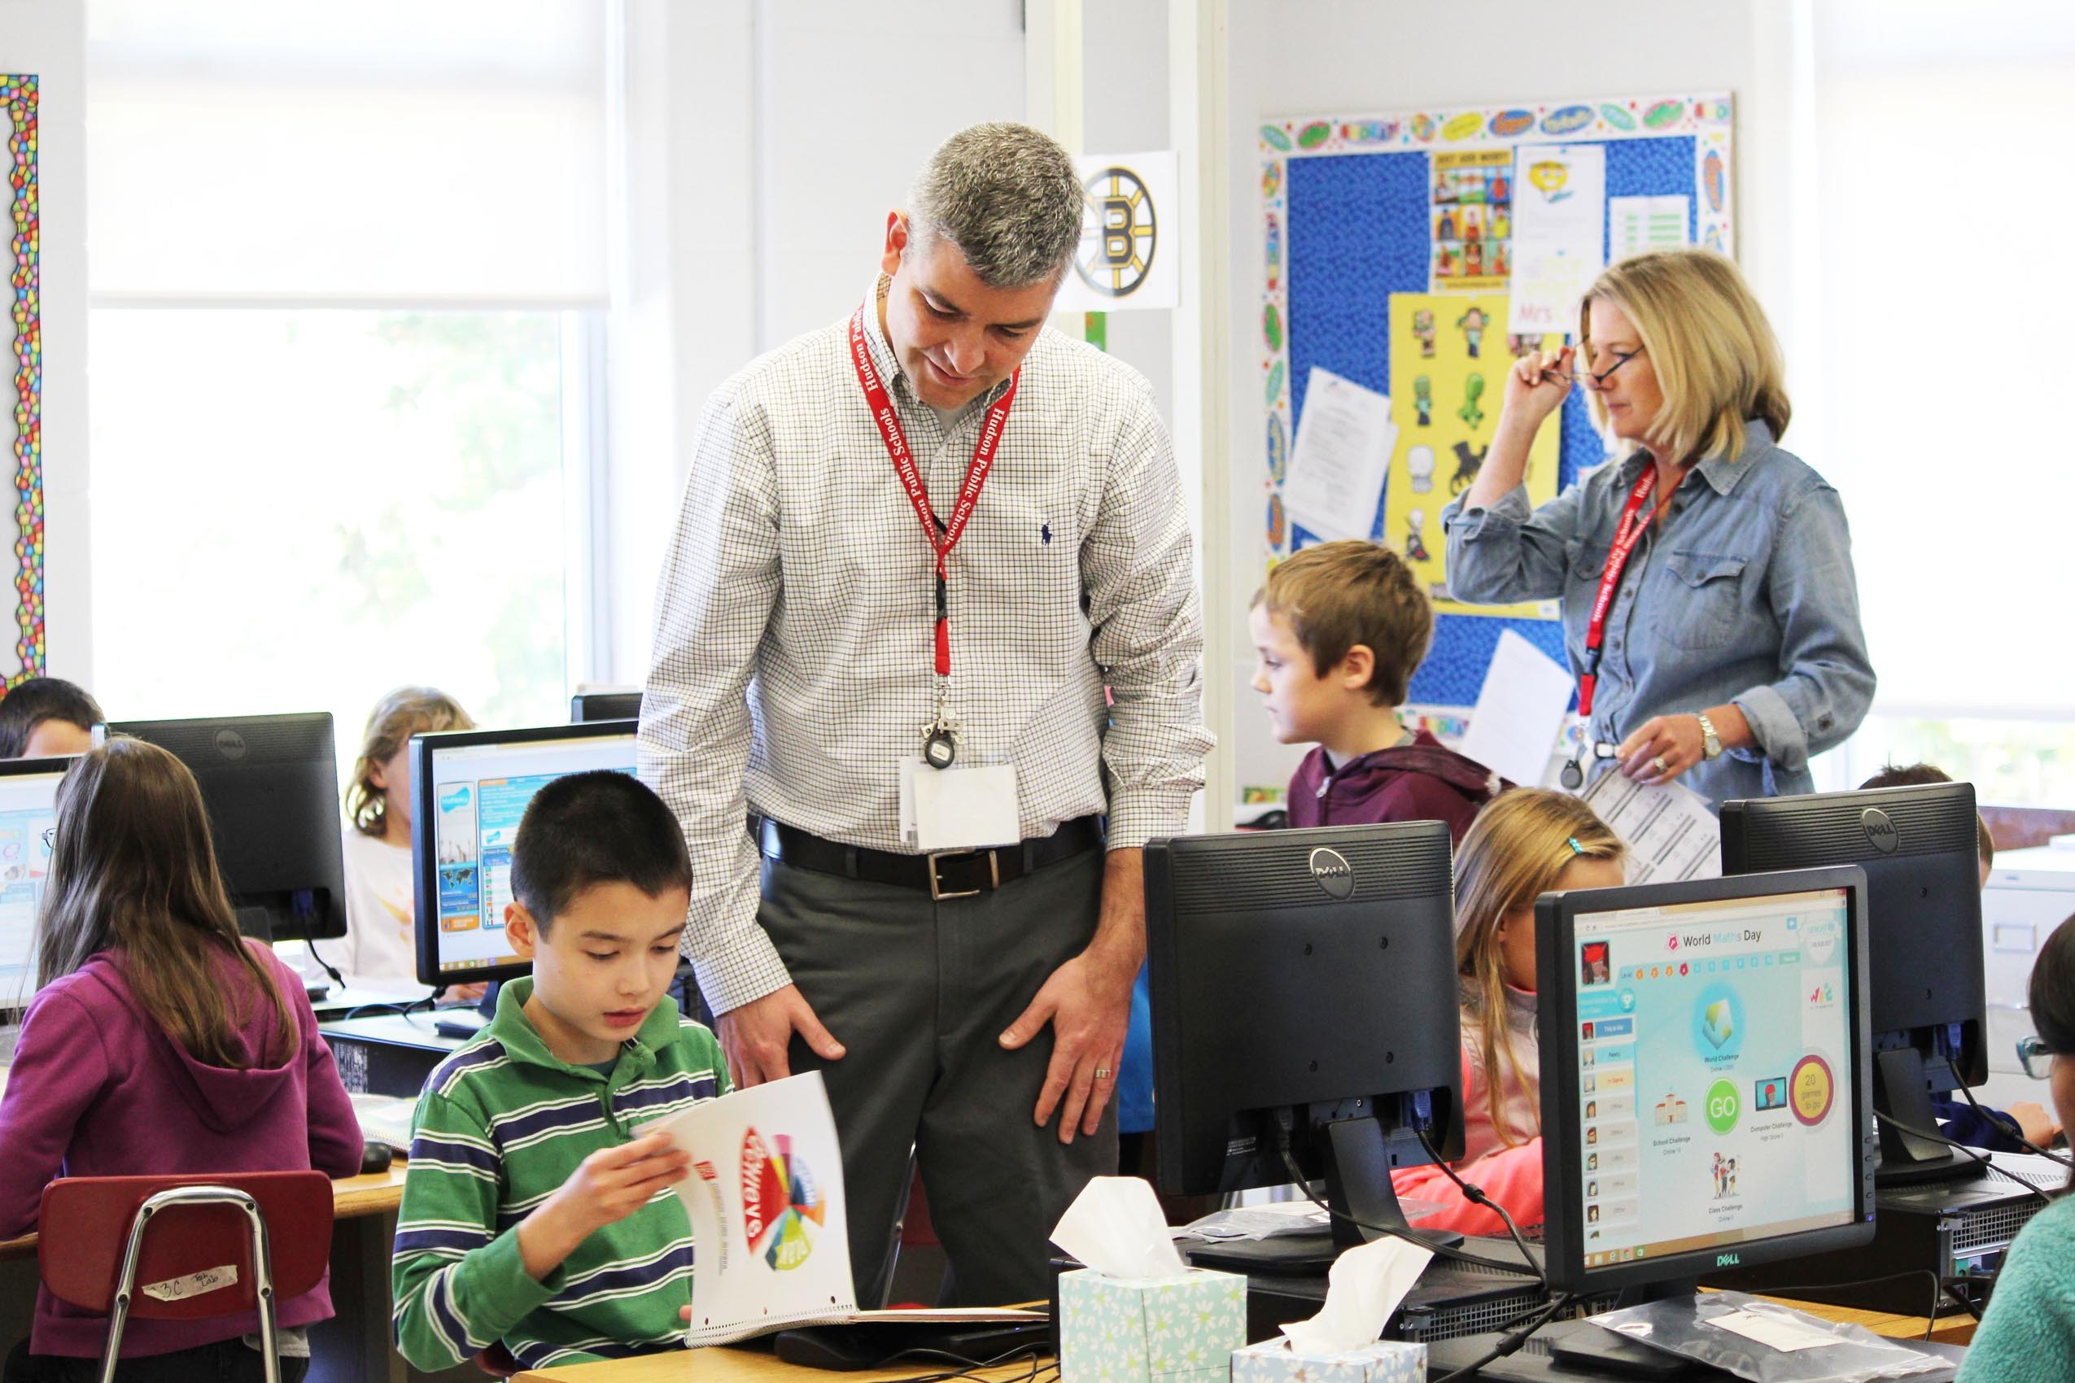
No assessments
No data
No analysis
No program improvement
Notes:
Here’s what we have with most of our non-academic outcomes.
No assessments
No data
No analysis
No program improvements
Sometimes we know that we need to make a change but like that last administrator’s comment, we know the students have changed, but without assessment, the changes are not based on data and are not systematic. We might even have made some changes, but we don’t know if we are hitting the target or not.

Slide 15
How?
The next question: How can we assess Non-Academic ESOs? Academics assessment is often “standardized.” But what about the non-academic? CREATIVELY! One at a time.
It is usually:
satisfaction (survey)
count (ex. incidents,hours)
interview/focus group
participation
self-assessment
often used with class assignments
rubrics
checklist/rating
activity
projects/portfolio
reflection/journal or pictures or narrative for young children
Notes:
So, the important question is…HOW can we assess our non-academic ESOs?
We use standardized tests for the academic outcomes but what about those non-academic outcomes? I’m going to talk about ten ways to do that. Hopefully, you will be better prepared once we go over these.
Satisfaction – THE MOST COMMON… perception data is important. You can ask kids anything from how they like their Bible classes? to Do you see any bullying at our school? And what kids think is happening is important. Different forms like a course evaluation as well as surveys and compare data from year to year. Satisfaction/Perception data isn’t the only type. It should be combined with these others.
Count (ex. hours) – You may also want to count things as well. This works well along with perception data. How many discipline events (bullying), suspensions, service hours, how many times a month to do students go to church, read their Bibles, students passing AP exams, students involved in peer tutoring or students helping ISP students, etc. You can also ask teachers how many of them mentor a student, how many students? This type of data supports the other types of assessments and yields very valuable information in its own right.
interview/focus group – this might be an exit interview (seniors before they leave) Often much more powerful than a survey. Or, can be combined with some survey questions as a follow-up.
Participation – similar to count, but required service hours but beyond that? % of the student body in missions/service above and beyond that? # or percentage taking AP exams, or involved in optional Bible studies. Sports (75% Wow!) Or is it 20%. Same with fine arts. Isn’t the required classes. It is the optional classes above and beyond.
self-assessment – very valuable, especially when combined with rubrics. Some reflection question can dig deep.
Rubrics – If I were prioritizing these, I would put this one first! You can add this to anything, almost. For example, if you have done a biblical integration concept in a unit in history or computer or English, then have an essay on your unit test. Grade it according to the rubric you have shared with the students that identifies the competencies you are looking for. If this is material you have taught, yes, it can be counted in the grade. For example, when I was teaching computer and I taught on piracy, privacy, ethics, etc. I used essay questions to cover the biblical integration concepts I taught in those units. I prepared the students for that essay and gave them the rubric ahead of time so they would know how I was planning to grade that essay question. The other point that I wanted to make here about rubrics is that the essay or part of the project that is graded by the rubric for assessing ESOs can be pulled out later for analysis for the assessment report. We did that regularly.
checklist/rating (might be appropriate for a skills class like art, music or PE, or perhaps a sport, etc.)
Activity – Examples – we may be tempted to ask children in elementary school if they know Jesus as their Savior. (They will likely say yes.) But perhaps that is not the right question to ask. So our school chose five grades and particular activities to tie those assessments to. (in grade 1 – made a bracelet with the five colors representing aspects of salvation, can they explain what those colors stood for individually with teacher/aide?, in grade 3 – can they share the gospel with a friend (role play)?, in grade 8 students spent weeks working on salvation, writing their personal story, writing their testimony, interviewed individually with HS principal). In HS, they chose one other religion and explained the Christian faith to someone of that other faith in a roleplay or paper. The assessments gave us the information about what students believed, and gave teachers an opportunity to follow up with those who were questioning, doubting, unsure, or who simply could not articulate their faith in these various ways.
projects/portfolio (think of this as evidence that several of the competencies are present) again, you will develop the criteria or rubrics (ex. Senior Capstone project will have both academic and non-academic ESOs but really any project-based learning will have these because it is a more holistic type of work)
reflection/journal (or pictures or verbal narrative for young children) – I love to share the example of one of our teachers who took an activity that we had done for years…raking leaves for the poor elderly in the neighborhood. Asked the kids why they did it…”Not sure. To get out of school?” The teacher decided to use this as an “assessment” so the month before, he started sharing some verses on the board about the poor with the students and had them reflect on those verses in their journals. There was a little bit of discussion but not a whole lot. That year, they went and raked leaves again. Students then came back and wrote in their journals. They had a completely different reaction. They had interacted with the people. Found out about their lives. They found out they were poor. And they asked to do it again! The competency ~-is a responsible citizen in the local community and the world and ~can articulate the biblical mandate for service and missions, including responsibility to the poor and lost (What I don’t want you to miss here is that intentionally doing the assessment brought far more meaning and value to an activity that we just assumed was valuable, when it wasn’t. Without the assessment, it was just an activity.)
We’ll talk about several of these and I’ll give some examples of how they are used. What I would not suggest is relying on perception data alone. Not all students are mature enough to be self-aware or are willing to be completely honest. That should be one measure but not the only measure.

Slide 16
SMART Outcomes
Specific
Measurable
Attainable (and aggressive enough to be challenging)
Results Oriented
Time-bound
You’ve heard of SMART Goals. These are very similar.
Notes:
I want to interject a slide here on SMART goals or Outcomes so that you are reminded how to write these well.
(Adopted from Peter Drucker) Make sure the assessments are written in this way. And it helps if your competencies lend themselves to this as well.
Specific (Clear and definite terms describing the knowledge, skills, values, and abilities.)
Measurable (It is feasible to get data; accurate and reliable data; multiple methods of assessment.)
Attainable/Aggressive (The outcome has the potential to move the course or program forward.)
Results-oriented (Describe what standards are expected from students.)
Time-bound (Describe a specified time period for accomplishing the outcome.)
For example, we talked about objectives at the beginning. We all want our students to be “mature in Christ.” I’ve seen that as an Outcome. But when that is defined at the competency level, you need to describe what that looks like in the 18 year old graduate. Do you expect them to have led hundreds to the Lord, written a commentary, of course not! What do you expect?

Slide 17
School Improvement
Once completed, results will be analyzed on two levels. A. Micro – teachers ask three important questions if students did not meet the expected benchmark.
Was the assessment appropriate?
Was the instruction adequate to prepare students for the assessment?
What students did not meet the benchmark?
  Absent for sports? Special needs or ELL?
What do I do with the students who don’t meet the goal?
B. Macro level – schoolwide, administrators ask about strategic planning, program improvement, curriculum, hiring, etc.
Notes:
We’re going to jump ahead for a minute so that we’re clear about what we’re going to do with the results. Once you have completed the assessment, the results must be analyzed to be valuable. They are analyzed on two levels:
Micro – teacher (departments)
Macro – schoolwide (administrators/board) How is the school doing overall? Are we meeting our ENDS?
1. Micro - The teacher asks themselves these questions if students did not meet the expected benchmark.
Was the assessment appropriate? Not good? Not well-aligned? Not well calibrated?
Was the instruction adequate to prepare students for the assessment?
What students did not meet the benchmark?
Absent for sports? Special needs or ELL?
What do I do with the students who do meet the goal? Develop a Remediation Plan. Work with them!
Each class is only required to do a few outcomes each year. We spread ours throughout the grades K-2, 3-5, MS, and HS. Not every subject and not every grade, every year. And remember, these fit on one piece of paper. Most teachers had 3-4 in the year.
Teachers took the responsibility to make sure students accomplished these.
Data in the hands of good teachers is a powerful thing!
B. Macro level – schoolwide, administrators ask about strategic planning, program improvement, curriculum, hiring, etc.

Slide 18
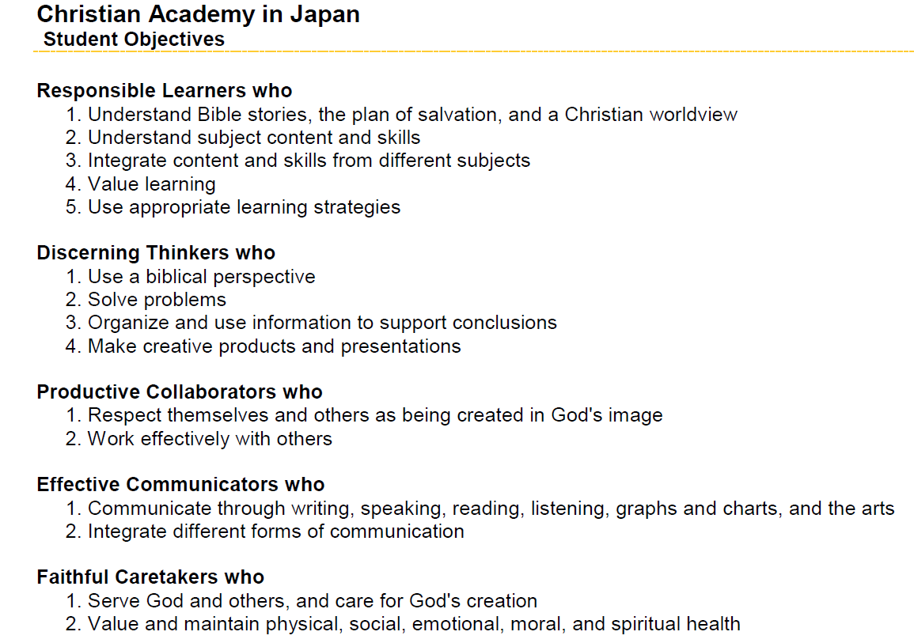
Notes:
Instead of giving you a lot more theoretical principles, let me give you several examples.
I’m going to pull these three examples from the Christian Academy in Japan’s ESOs.

Slide 19
How Can We Assess Non-Academic ESOs
Example #1: Discerning Thinkers who…
  1. Use a biblical perspective
  2. Organize and use information to support conclusions
7th Grade Language Arts reading/writing
Some long, some short selections
Each month, students identify a biblical theme/Christian principle in a reading selection
Describe the principle that is or is not demonstrated.
Support with scripture.
Tell how person should have acted and what outcome that may have produced.
Describe how that was (or was not) an example of bib princ.
Semester exam – similar task from a short selection
Notes:
The first idea is “Discerning Thinkers Who…use a biblical perspective.” and Organize and use information to support conclusions. (Read the activity off the slide.)
I’m a big believer in doing an activity in class that can also be used as an assessment. If it is well-structured, it can be both.
Example #1: Discerning Thinkers who…
1. Use a biblical perspective
2. Organize and use information to support conclusions
7th Grade Language Arts reading/writing
Some long, some short selections
Each month, students identify a biblical theme/Christian principle in a reading selection
Describe the principle that is or is not demonstrated.
Support with scripture.
Tell how person should have acted and what outcome that may have produced.
Describe how that was (or was not) an example of bib princ.
Semester exam – similar task from a short selection
The theme identified might be compassion, forgiveness, mercy, sacrificial friendship, etc. The student may also describe the missing biblical trait and describe how the lack of love was the tragic flaw for this individual. The story doesn’t have to be a Christian story for the student to identify that theme. (Bridge to Terabithia, Lord of the Rings, etc.) Or studying works of an author like Edgar Allen Poe, one might look at themes of guilt and hopelessness in The Tell Tale Heart or the Raven and reflect on the contrast of a life in Christ. Self-centeredness in The Great Gatsby. Self-sacrifice in The Hunger Games.
Even when students are not actually writing about a story, a simple class discussion might occur. Class, what biblical principles did you notice in this story? “Lies have a way of coming out in the end. Evil will not go unpunished.” Or something like “Sara didn’t know that this situation was being solved in a completely different way than she expected. Sometimes God works like that in our lives. He helps us through a tough situation but it is not all the way we think it should happen.”
What are we learning about life? How are we looking at that from our biblical worldview? These students choose a principle that is in evidence or the opposite and they discuss it. Topic sentence, several major points, evidence, and a conclusion. Throughout the year, there will be tremendous growth. Over 2-3 years, the school will develop some good writers who are trained to look at anything from a biblical worldview.
True in MS as well. 7th grade English example…Friendship
How does the world see friendship? What can I get out of it?
How does a Christian see friendship? Like Jonathan and David, Naomi and Ruth, Paul and Barnabas. How can I be the best friend possible in a difficult situation, like the one in the literature selection?

Slide 20
How should we grade it?
Teach how to identify biblical principles – examples and non-examples
Develop a rubric on how to write about them – for Christians and non-Christians
Weave that together with good principles of writing (thesis statement, logical points, evidence, conclusion, balancing personal opinion, facts, etc.)
How could we report on this?
  Target skills (identify biblical perspective)
  Spiritual formation (reflection of belief)
  Related skills (writing or speaking)
  Compliance (on time, spelling, grammar, following directions, etc..)
Notes:
Teach how to identify biblical principles – examples and non-examples
Develop a rubric on how to write about them – that works for Christians and non-Christians (covenant school or not, ISP students, those seeking, doubting)
Weave that together with good principles of writing (thesis statement, logical points, evidence, conclusion, balancing personal opinion, facts, etc.)
As the teacher reports on this assessment, they may report on:
How did the students do on identifying the biblical perspectives?
Did the students internalize these beliefs, hold them as their own? Or view them from another perspective and support that view?
How did they do on the related academic skills? (information, persuasive, did they make a case for this, provide evidence)
How did they do on the nuts/bolts?

Slide 21
Example #2
Productive Collaborators who…
  1. Respect themselves and others as being created in God's image
  2. Work effectively with others
Assignment/Assessment - 5th grade – Group work
Study attributes of God, everyone made in image of God.
Each group take some attributes.
Identify strengths in group members
Choose to present in a variety of ways to the class.
Notes:
Read the Outcome and competencies…Let’s take this one from a 5th grade example.
The class is studying attributes of God AND how everyone is made in the image of God. Attributes are divided up and given to groups. Students work together to decide which attribute of God each is going to focus on. Then they work together to identify strengths in the individuals that are similar to those characteristics of God. They can choose to present those in a variety of ways for the class. (poster, skit, story, poem, etc.)
God is love…a student may be known for the love they show to others. The student presenting may give an example of how that student may have shown love.
God is just…a student may be known for his/her sense of fairness. They always step in and try to right a wrong they see. The student presenting may predict that the student he/she is describing may someday become a judge or a teacher.
God is all-knowing…a student may be known for his/her high academics, being intuitive, able to speak, think understand in ways that others may not. Student makes their presentation a message of thanks to God for our brains and is thankful that this student is in his/her group.
Activity ends up AFFIRMING students, learning more about the characteristics of God, seeing those traits in others, bringing group closer together, and meeting both outcomes.

Slide 22
How should we grade it?
Develop a rubric on what points should be included
How to present these – for Christians and non-Christians
How could we report on this?
  Target skills (biblical knowledge, God’s attributes)
  Personal skills (affirmation of one another)
  Group work (have them rate their own and others’ group work on a simple scale and add a comment)
  Compliance (on time, spelling, grammar, presentations, following directions, etc..)
Notes:
READ slide first…
As the teacher reports on this assessment, they may create a rubric that identifies:
How did the students do on identifying the biblical knowledge?
Was the student able to relate characteristics of God to human characteristics?
How did they do on the related skills? Group work, presentation?
How did they do on the nuts/bolts?
Since you would want to evaluate this on an individual level, you could include several self-assessment questions…short answer, reflections, etc.

Slide 23
Example #3
Faithful Caretakers who…
  Serve God and others, and care for God's creation
Assignment/Assessment – High School students at a school with mandatory service requirement
__# hours of required service.
Bible class, once a month, journal about one of those hours. These need to be ten unique experiences.
Students can share that they like it or not…that they think it is worthwhile or not.
They do need to respond to several questions/prompt
What does the Bible say about serving others? The poor? Our attitudes? Matt. 2:28 or Mark 10:45…
Notes:
1 hour of service required per week?, 8 per quarter?
Verse about Jesus coming to serve, not be served
Could be a question, a verse, or something that is happening in the news…like the refugee crisis. How does serving the poor in our community help you to better understand the refugee crisis around the world?
This reflection might occur in a journal, a small group discussion, a poster, whatever.

Slide 24
How should we grade it?
Develop a rubric on what points should be included (length, depth of answers)
Include the required questions, verse, or prompt
How could we report on this?
  Target skills (concepts about serving, the poor, care of creation, Jesus’ attitude)
  Spiritual formation (reflection of personal and spiritual growth, maturity?)
  Compliance (on completing the service hours, completing the journaling, length, on time, etc.)
Notes:
Separate out the pieces…concepts, personal/spiritual maturity, and compliance with the nuts/bolts
Don’t be confused about grading and reporting on these items. I would grade on Target Skills and Compliance but not on Spiritual Formation. I would collect information on that and report on it.
This is so often why educators in Christian schools hesitate to capture this information. They get confused and think they are “grading a student’s spirituality.” Not at all! They are collecting information about signs of spiritual growth so that they know where their students are, so they meet them there, follow-up with them, and shape their instruction. They only grade them on the logical or academic aspects like you would any other assignment that is appropriate for the class in which the activity occurs.

Slide 25
Next three slides – Practice!
The next three slides could be used as practice for you or a small group discussion.
Read the ESO and related competency
Review slide 15 and see the various ways this could be measured. Ask yourself what you would want to know to prove to yourself or others that students possess this competency. What are the indicators? How can they show that?
Determine the level (ES, MS, or HS) and subject area (Math, Sci., Bible, SS, etc.)
Write an assessment with some measurable aspects so that your group would be able to agree if students had “passed.”
Notes:
The next three slides could be used as practice for you or a small group discussion.
Feel free to stop the presentation after the competency is shown on the screen and then work as an individual or group to try and come up with an assessment that might work. There are no right answers for these. However, I have given you a possible answer so that you can see what I might do with it.
You can stop the presentation again and discuss what you like or don’t like about the solution I have given you. You could also go back and modify the one you created.

Slide 26
Examples of assessing ESOs
ESO: respects the worth of every individual as made in God’s image
Competency:
able to relate well and work well with others
Math classes – do these 8 times a year
Rating of how group works together along with a self-assessment, provided with specific rubric (well-known and communicated to the class)
Math teachers chart scores and review them with the class, leading a discussion about how the class has improved over time and what they still need to work on (2-3 times during the year)
Results of first and last ratings are reported in annual assessment report
Notes:
Read the ESO and related competency
Review slide 15 and see the various ways this could be measured. Ask yourself what you would want to know to prove to yourself or others that students possess this competency. What are the indicators? How can they show that?
Determine the level (ES, MS, or HS) and subject area (Math, Sci., Bible, SS, etc.)
Write an assessment with some measurable aspects so that your group would be able to agree if students had “passed.”
Stop the presentation after the competency comes on the screen. Write the assessment. Then continue.

Slide 27
Examples of assessing ESOs
ESO: respects the worth of every individual as made in God’s image
Competency:
understand others’ viewpoints and perspectives on life
HS Literature classes – do these 4 times a year
Develop a rubric together as a class to help students understand the idea of multiple perspectives (point, counterpoint arguments)
Four times a year, an assignment will contain these items in the grading rubric along with regular grading items for literature review essays
Results of first and last ratings are reported in annual assessment report
Notes:
Read the ESO and related competency
Review slide 15 and see the various ways this could be measured. Ask yourself what you would want to know to prove to yourself or others that students possess this competency. What are the indicators? How can they show that?
Determine the level (ES, MS, or HS) and subject area (Math, Sci., Bible, SS, etc.)
Write an assessment with some measurable aspects so that your group would be able to agree if students had “passed.”
Stop the presentation after the competency comes on the screen. Write the assessment. Then continue.

Slide 28
Examples of assessing ESOs
ESO: Demonstrates well-balanced, emotionally healthy living
Competency:
applies learning to healthy choices affecting lifestyle
MS classes, combined paper or project (with choices)
Develop a rubric together for the five disciplines
Have each teacher explain their discipline’s contribution to the project and why their area provides an important aspect to the whole
Paper/project is graded on content but separately, teachers can collect the rubric ratings that pertain to the competency above.
Results are reported in annual assessment report
Notes:
Read the ESO and related competency
Review slide 15 and see the various ways this could be measured. Ask yourself what you would want to know to prove to yourself or others that students possess this competency. What are the indicators? How can they show that?
Determine the level (ES, MS, or HS) and subject area (Math, Sci., Bible, SS, etc.)
Write an assessment with some measurable aspects so that your group would be able to agree if students had “passed.”
Stop the presentation after the competency comes on the screen. Write the assessment. Then continue.
Finally, if one of the outcomes is “applies learning to healthy choices affecting lifestyle”
then perhaps all the MS teachers in Bible, PE, Health, Science, and English can team up and do an
2- interdisciplinary unit on lifestyle choices. The negative effects of alcohol, drugs, inappropriate sexual behavior, poor eating, and lack of exercise are overwhelming in our society and destroying our families. Perhaps a new, combined approach with community involvement could make an impact on our next generation. Organizing learning around this outcome could change students’ opinions about these topics in a way that might be life-altering.
MS classes, combined paper or project (with choices)
Develop a rubric together for the five disciplines
Have each teacher explain their discipline’s contribution to the project and why their area provides an important aspect to the whole
Paper/project is graded on content but separately, teachers can collect the rubric ratings that pertain to the competency above.
Results are reported in annual assessment report

Slide 29
Grading
Biggest obstacle…you can’t grade “issues of the heart”
Correct and Incorrect.
We never want to put a grade on student’s honest reflection of their heart. A=believe, F=not
However, we can grade many aspects.
  Did you learn the material?
  What do you think, and explain your thinking.
  What would be a biblical worldview in this situation? (Never make them say it is theirs.)
  Reflection, journaling, self-assessment, explain why a Christian thinks, give biblical support for, Why did Jesus say?, interview others, etc. Follow-up!
  MAKE IT SAFE TO BE HONEST!
Notes:
Biggest obstacle I hear is that you can’t grade “issues of the heart”
That is both Correct and Incorrect.
We never want to put a grade on student’s honest reflection of their heart. A=believe, F=not
However, we can grade many aspects. MAKE IT SAFE TO BE HONEST!
Create the rubric to reflect all these areas…
Did you learn the material?
What do you think, and explain your thinking. The grade depends on your logic and evidence…not agreeing with what the teacher would say.
What would be a biblical worldview in this situation? (Never make them say it is theirs. But they can be held responsible for learning what the biblical or Christian perspective is.)
Reflection, journaling, self-assessment, explain why a Christian would think this way, give biblical support for, Why did Jesus say?, interview others, etc. But they also should be able to say honestly what they believe as long as they respectfully explain why. Follow-up! MAKE IT SAFE TO BE HONEST!

Slide 30
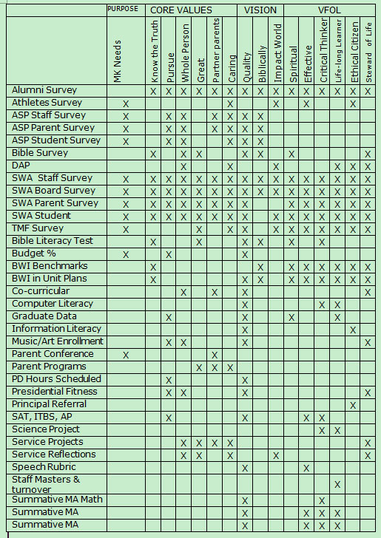
Other data?
Surveys
Numbers of…
  Enrollments
  Conferences
  Referrals/Students discipled
  Projects/entries
  AP Tests/Credits earned
  Service hours
Test scores/awards
Classroom evaluations
Reflections
Notes:
The last step is pulling all this together in a meaningful report. How do you collect information for all the outcomes? The macro (schoolwide) analysis…
There are several ways that I know of. I will share three school’s approaches.
A chart like Morrison Academy (Taiwan) uses – lots of surveys, collecting of numbers that indicate how many do this/that, how many have completed this/that. They pull this together in a narrative summary and I believe they put out those results on an annual basis.

Slide 31
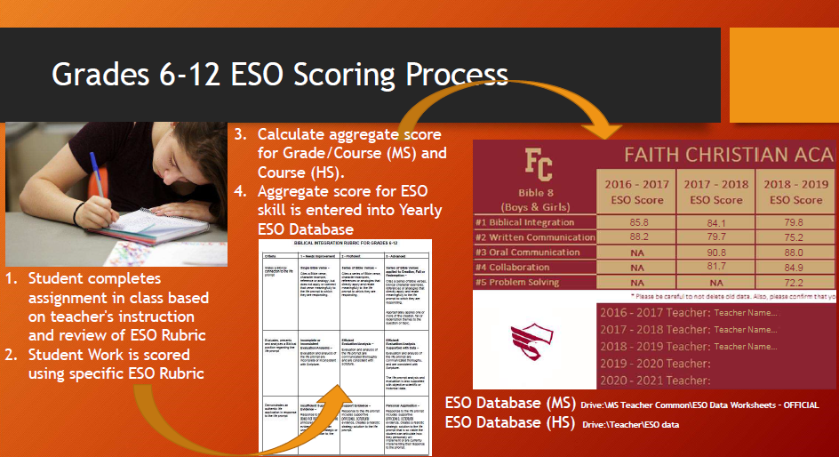
Collaboration
Problem Solving
Biblical Integration
Written Communication
Oral Communication
Notes:
A second school, Faith Christian School, near Denver Colorado, does it completely differently. They have chosen five outcomes that they want to measure across the curriculum in grades 6-12. They are biblical integration, written communication, oral communication, collaboration, and problem solving.
Students complete an activity/assignment in every class that will yield this type of information. These are carefully selected, one or two per year in each class.
Student work is scored on the appropriate ESO rubric.
The aggregate score for the whole grade level is computed for that ESO. (10th grade, 12th grade, etc.) The teacher is responsible to look at individual scores and the scores for their class. The administrators are looking for more macroor schoolwide trends. Are our students meeting the criteria for writing? For problem solving? For biblical thinking? Etc.

Slide 32
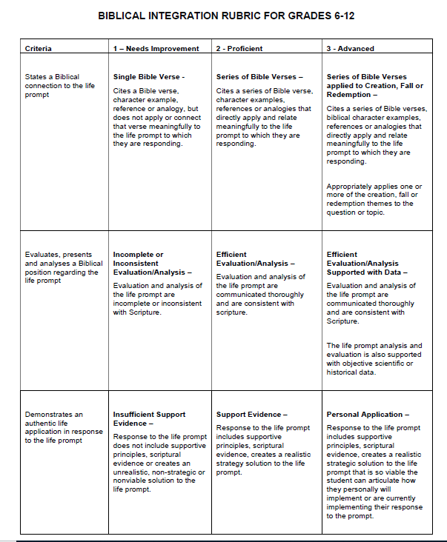
Notes:
This is an example of one of their rubrics. It is called the “Biblical Integration Rubric” but really the focus is on the student. So, it might be better called, “Biblical Thinking.”
You can see that it is very simple. They have chosen to have only 3 aspects, you might have more. Or you might keep it simple so that teachers can be easily trained and become consistent on its use.

Slide 33
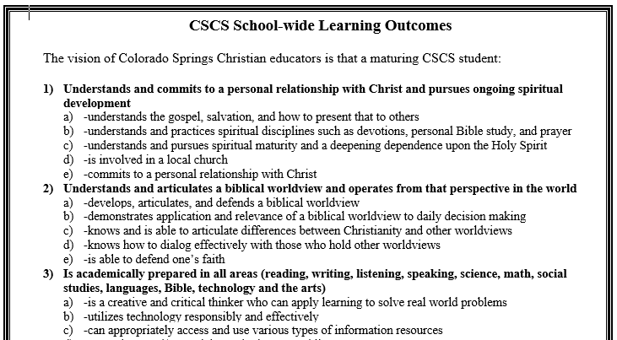
Notes:
The third example is an assessment report like one of my former schools used. We designed assessments targeted to each Outcome/competency and then collected data on those assessments.
So how do you know you’ve got everything covered?
For example, at our school, we had seven Outcomes, with competencies underneath (labeled a, b, c, d) Others call these subpoints “indicators” These competencies are more specific, more observable, and more measurable.

Slide 34
Each division is analyzed by Grade Level
 | K | 1 | 2 | 3 | 4 | 5
1 A | X |  |  |  | X | X
B |  | X
C | X |  |  | X
D |  | X |  |  | X
E |  |  |  | X | X | X
2 A |  | X | X
B | X |  | X
C
and
Department
 | Eng | Soc Stud | Math | Science | Bible | For Lang. | PE
1 A | X |  |  |  | X | X
B |  | X |  |  |  |  | X
C | X |  |  | X
D |  | X |  |  | X
E |  |  |  | X | X | X
2 A |  | X | X
B | X |  | X
C
Notes:
We used a chart like this. Elementary, grade levels across the top. In grades 6-12, we put the departments across the top. We listed the Outcomes/competencies down the left side.
Our teachers divided up the competencies and we committed to covering them K-2, 3-5, 6-8, and 9-12.
We charted them by grade level and by department so that we knew what was being covered in English, Social Studies, Math, etc. We didn’t insist that every department covered every Outcome. Some outcomes lend themselves to be covered by Bible, or PE, or math and so those departments would volunteer to cover those. Because they fit right into the curriculum.

Slide 35
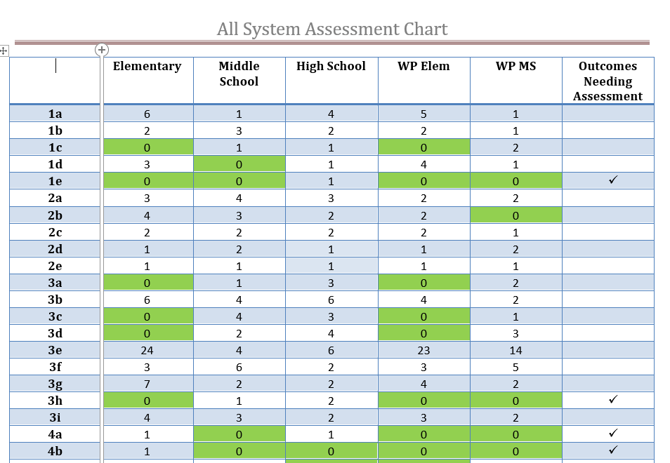
Notes:
Part way through the year, the principals turn in their assessment chart to me. This might have been from the spring. The chart showed me which Outcomes/competencies had assessments turned in, which ones still had 0, and which ones may have needed to be revised that year.

Slide 36
Compile the Data
From the targeted assessments, a summary is compiled (from the divisions)
The summary is reviewed for:
  Any benchmarks that have been set (met?)
  Trends (increases or decreases)
  Insights and connections
  Changes that need to be made
    Changes in the assessment (not valid)
    Changes in instruction
    Intervention with a special population (absent, special needs, ELL, ISP)
Notes:
Then what do we do with this information?
We compiled the data…
The summary is reviewed for:
Any benchmarks that have been set (met?)
Trends (increases or decreases)
Insights and connections – hmmm, does this increase/decrease relate to a change in personnel? Or curriculum?
Changes that need to be made – teachers reported on analyses they had done
1. Changes in assessment – too long, too complicated, grading not clear, rubric needed to be changed, no longer fit instruction?
2. Changes in instruction – may have changed, textbook or time on unit has changed?
3. Only one segment does poorly – who? Why? (maybe they are new to our school!)
Intervention with a special population (absent, special needs, ELL, ISP)

Slide 37
School-wide Learning Outcomes
  A Report on the Monitoring of ENDS, Curriculum Design, Assessment and School Improvement
Table of Contents
Executive Summary
Curriculum Design
  History and Process
  Assessment and Analysis
  Conclusion
School-wide Learning Outcomes with competencies (Adopted October 2006)
Yearly Monitoring Reports
  Elementary
  Middle School
  High School
  Woodland Park
  All School Summary
Appendices
  Appendix A – Curriculum Design Model
  Appendix B – Mapping of Outcomes to ENDS
Notes:
Remember, these fit on one page such that we spend 13 years working to master these essentials, we’re going to do our best to give them these skills when they need them. We took the approach that the Outcomes and the assessments we used to measure them identified essential buildings blocks. Teachers grasped that since they only had about 3 in each class, each year. They worked hard to make sure their students had those competencies before moving on.
Data in the hands of good teachers is a powerful thing!
Regardless of the method you use for collecting/analyzing the assessments, you will need a way of reporting on them to constituents.
This is an example of the Table of Contents of the ESO report we did at our school. The difference was in the detail we provided Yearly Monitoring Reports section.
Full version – Superintendent and administrators (much more detail and all scores)
Shortened versions for the board, parents, and teachers (overview, strengths, areas to improve)

Slide 38
Analyze and Communicate the Data
Summarize the entire report (Executive Summary)
  Discuss strengths and weaknesses (set goals)
Create appropriate versions for:
  Superintendent/Administration
  Board/Faculty
  Parents
Focus – School Improvement
…the path to excellence is one that finds us repeatedly asking how we are doing and how can we do better.
Notes:
The overall purpose of collecting these assessments is to have a better sense of how we were doing on the Expected Student Outcomes and to continue to progress in school improvement. I saw the benefit of this process and in the value of continuing this effort. These important goals were intentionally addressed, measured, and then analyzed. This process helped us improve our education in these important areas.
Over the years, it led to the creation of at least one new class, gave us input for our curriculum review process, helped us focus on more valuable homework, and less busywork, better biblical integration, better assessment of biblical integration, more interdisciplinary activities, and far greater emphasis on our non-academic expected student outcomes while increasing rigor in our academics. When you are working with staff to address your strengths and weaknesses, you naturally set goals to improve in these areas. When the report comes out the next year, you automatically compare…how did we do this year compared to last?
Who was extremely happy was our board…Our Outcomes report became a summary of how we accomplished the board ENDS, achieved our distinctives, met our goals, and set new ones each year. They encompassed who we were…an excellent Christian school. I hope the path to excellence is one that finds us repeatedly asking how we are doing and how can we do better. Assessments help us do that and so I pray we will continue to work with them to strengthen our schools in the process.

